Slide 1
LUX INVICTA TIMELINE AND MAPS
Here we have projected the happenings in the alternate history of Lux Invicta, event for event, in the form of maps showing names and places.
The original timeline is entirely the work of Shaytana, the creator of Lux Invicta. Most historical events that are unreferenced by Shaytana and don’t interfere with his changes are assumed to have happened as they did in our timeline. To help explain map changes, many of these details have been added and marked with an asterisk (*).
In addition to Shaytana’s timeline, more content has been written to help mesh the world of Lux Invicta with new areas of the map. As a rule, these additions will only target events that Shaytana hasn’t already mentioned, or ones that were only briefly referenced. Original content is always preserved in its entirety whenever possible, and changes are only made when necessary.
Any changes to original content are noted with italics. Additions made to the timeline have been written in boldface.

Slide 2
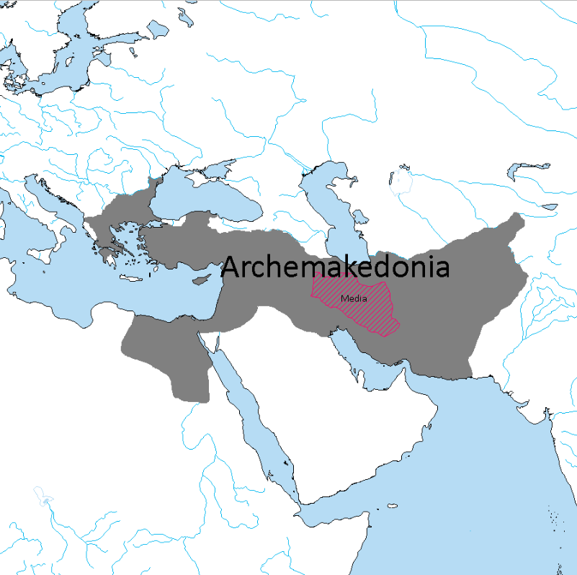
330 BCE
Megas Alexandros conquers Persia.
Beginning of implementation of policies regarding the Hellenic colonization of the East.
Parmenion is appointed Satrap of Ecbatana, his son Philotas sent to Media to oversee the creation of Hellenic military colonies in the region.

Slide 3
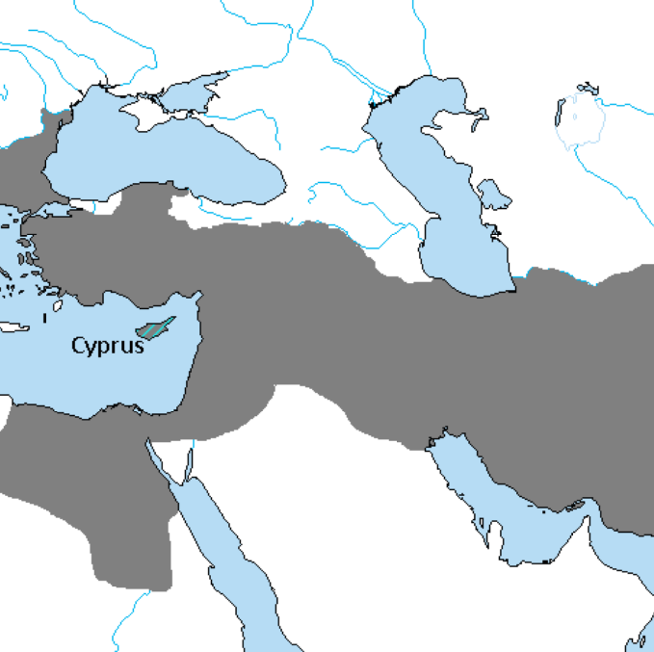
319 BCE
Megas Alexandros dies, poison is suspected to be the cause of death. He leaves behind several legitimate children by Roxana and Stateira, and several illegitimate ones widely acknowledged to be his.
His son Alexandros IV is blinded in an accident and following unrest he is taken by his mother and loyal retainers to Cyprus.

Slide 4
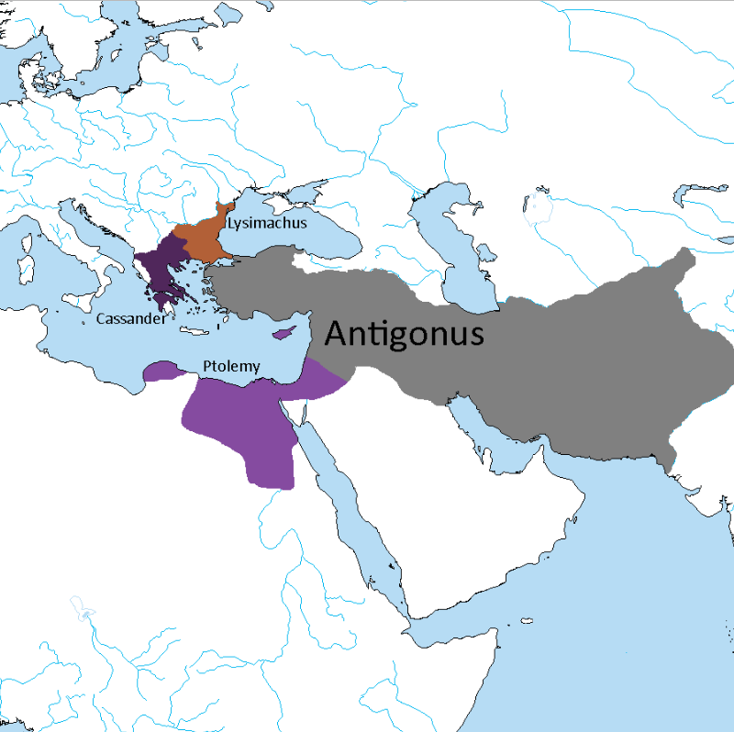
318 BCE
Diadokhoi Crisis starts in earnest.
Beginning of the division of the empire.

Slide 5
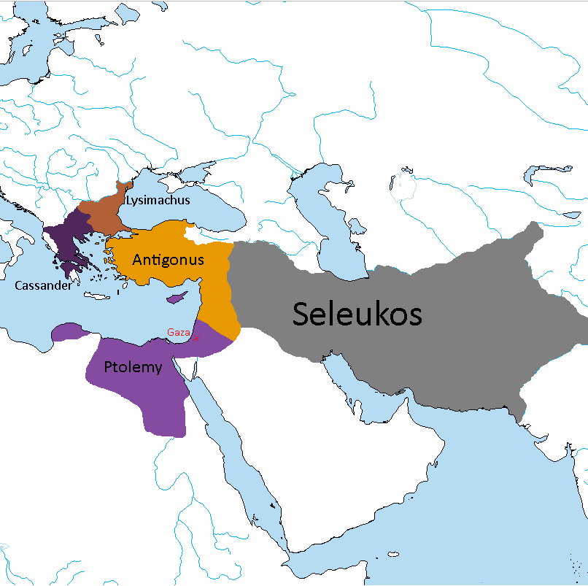
312 BCE
Seleukos I Nikator and Ptolemy I Soter defeat Demetrius I Poliorcetes of Makedon in the Battle of Gaza.
Beginning of Seleukid Era and creation of Arche Seleukeia.
*Demetrius I is the son of Antigonus.

Slide 6
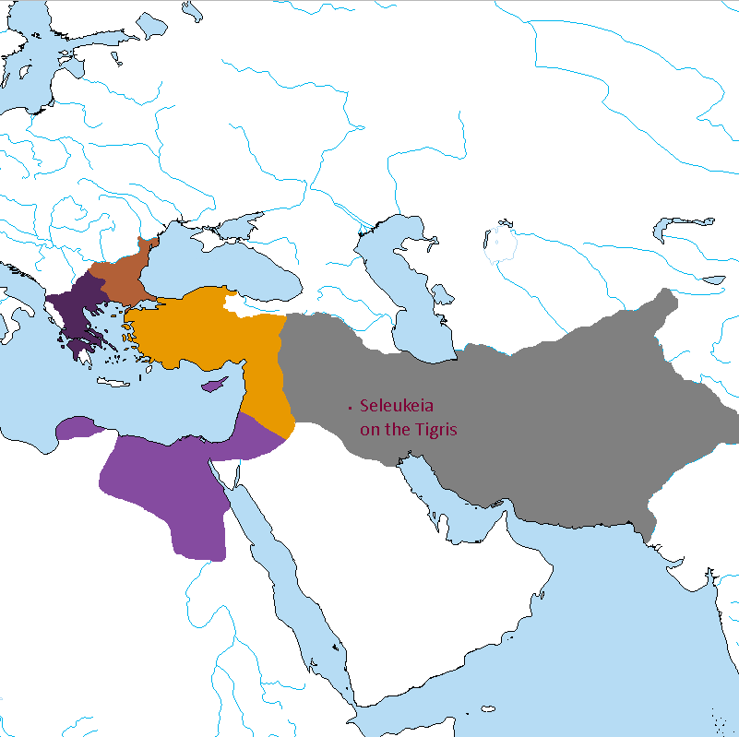
305 BCE
Seleukos I Nikator founds Seleukeia on the Tigris, his new capital.

Slide 7
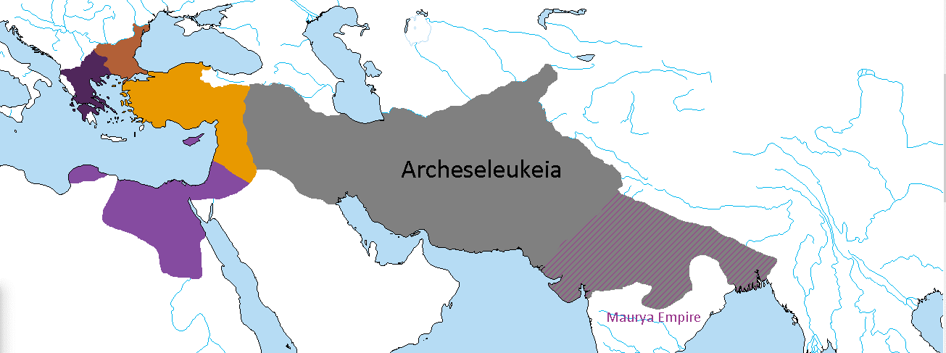
303 BCE
Seleukid Conquest of Sindhia.
Chandragupta Maurya becomes a Seleukid vassal.

Slide 8
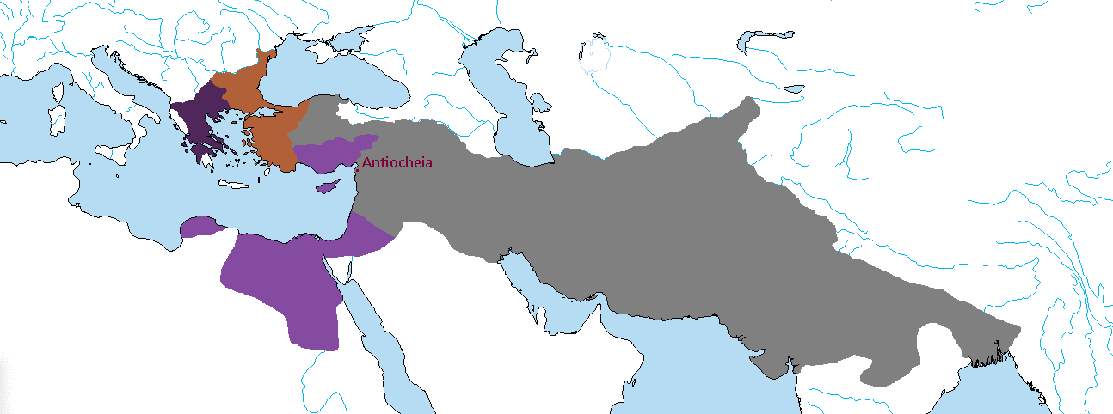
*Although he goes entirely unreferenced, Antigonus dies in 301 BCE at the Battle of Ipsos. Lysimachus receives the Aegean cost, while Seleukos and Ptolemy divide the rest of Asia Minor and Syria.
300 BCE
Founding of Antiocheia by Seleukos I Nikator, western capital of the empire.

Slide 9
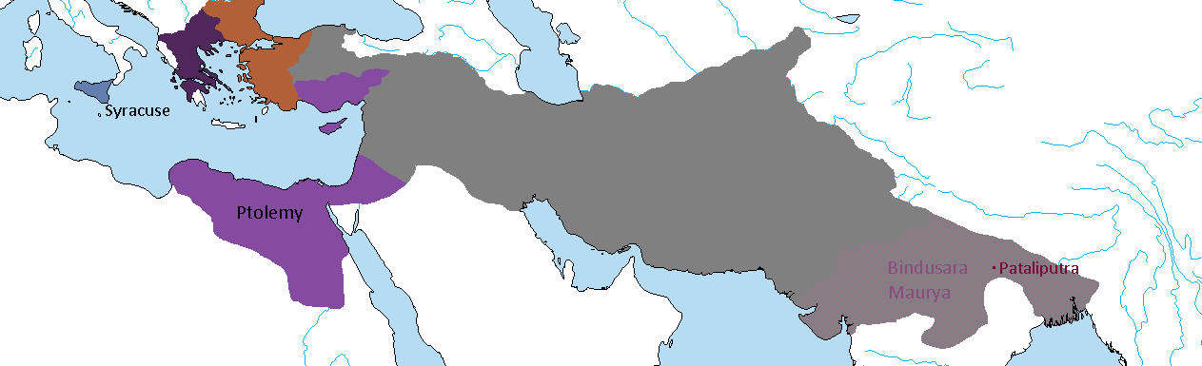
298 BCE
The Hieronid Agathocles of Syracuse unifies Sicily under his rule and marries Ptolemy's stepdaughter Theoxena.
Kyrene is brought under Ptolemaic control.
Chandragupta abdicates his throne to his son Bindusara and spends his final days in sallekhana (fasting to death) in a cave, according to the Jain tradition.

Slide 10
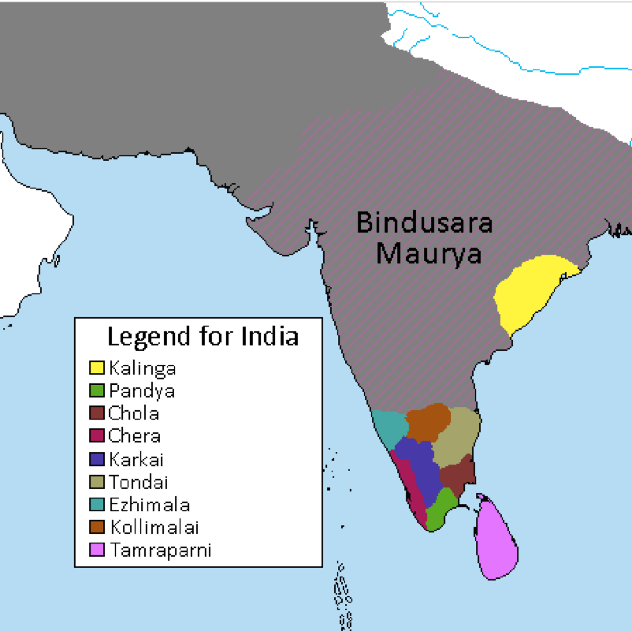
297 BCE
Bindusara expands the Mauryan Empire south into Deccan but decides not to conquer the entire peninsula in exchange for a wealthy tribute from the Tamil kingdoms.
*As in our timeline, he tried but was unsuccessful in conquering Kalinga.

Slide 11
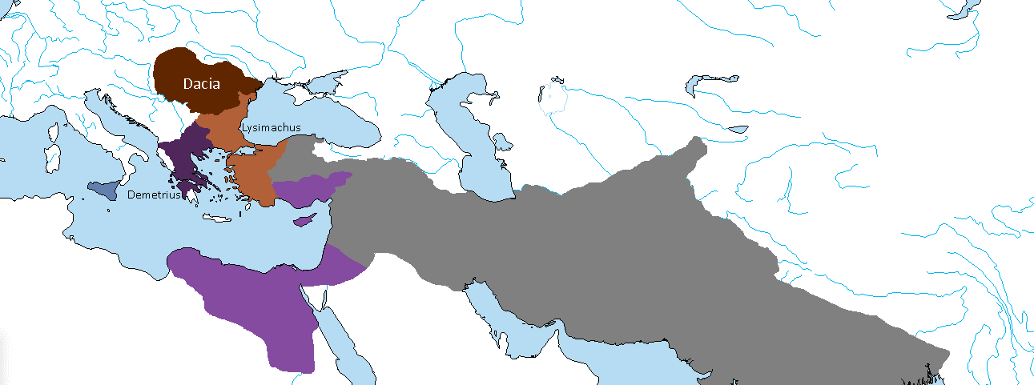
292 BCE
Lysimachus, Basileus of Thrakia campaigns beyond the Danube, but he is defeated and taken prisoner by the Dacian king Dromichaetes. Lysimachus is set free after the marriage of Dromichaetes with Lysimachus' daughter.
Hellenic influence over Dacia increases.
*Demetrius I has become King of Makedon by now.

Slide 12
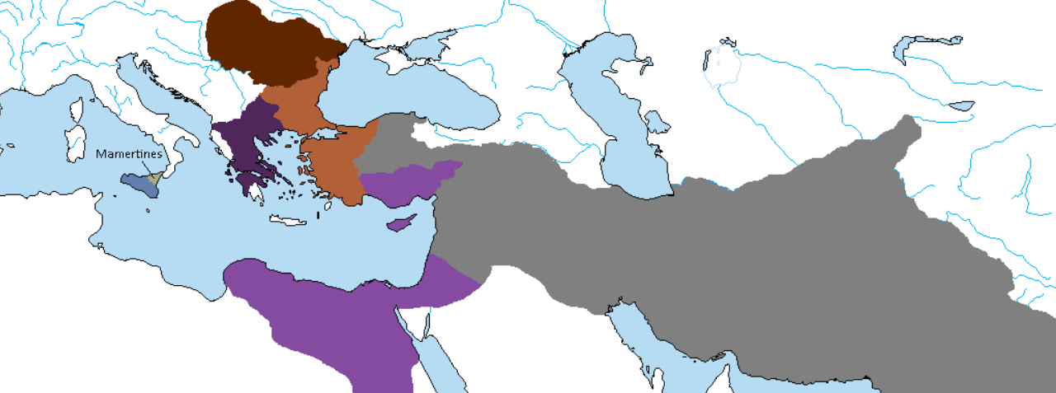
289 BCE
Agathocles of Syracuse dies, and a succession struggle ensues.
Mercenaries calling themselves Mamertines (“Sons of Mars”) take over Messana and the northeastern part of the island.

Slide 13
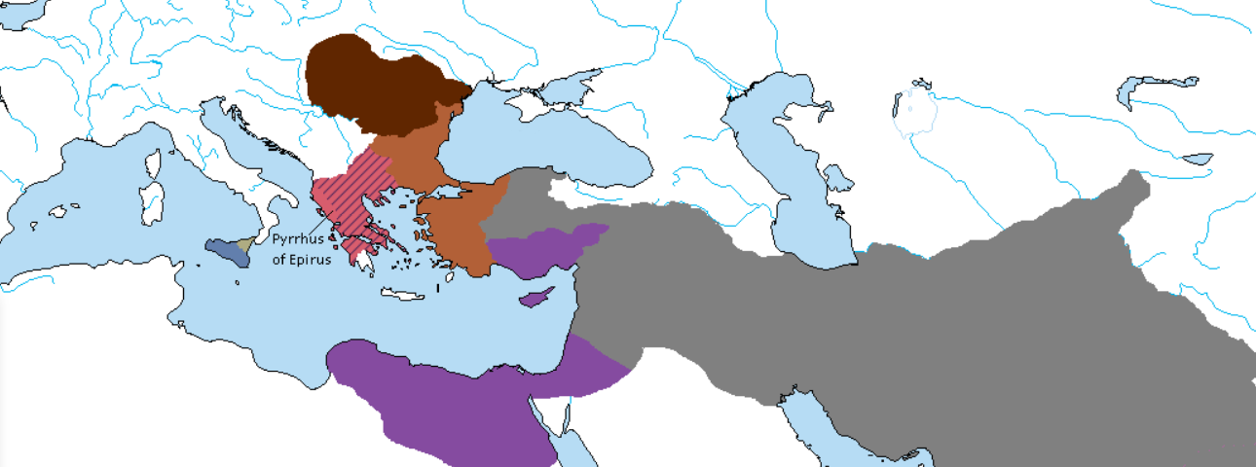
287 BCE
Pyrrhus defeats Demetrius I Poliorcetes and is proclaimed King of Makedon.

Slide 14
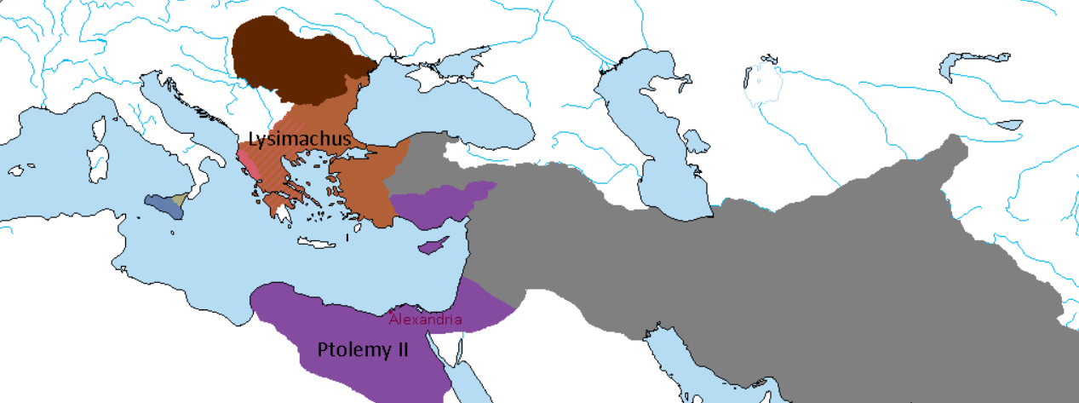
285 BCE
Ptolemy I Soter abdicates in favor of his son Ptolemy II Philadelphos. The Pharos of Alexandria is completed.
Pyrrhus is driven out of Makedon by Lysimachus with Dacian help.

Slide 15
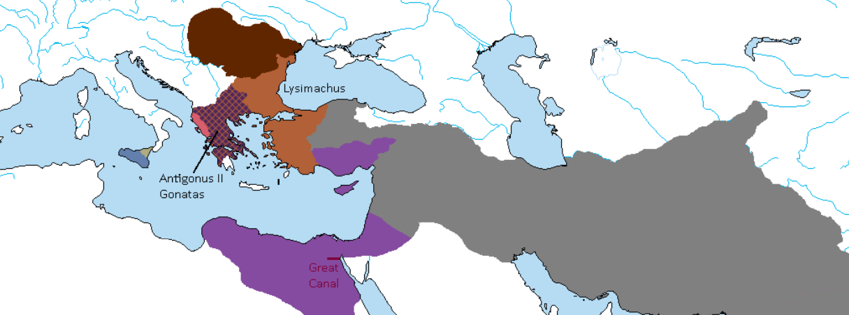
283 BCE
Antigonus, son of Demetrius I Poliorcetes becomes King of Makedon in name only as Lysimachus controls the Kingdom.
The Great Canal between the Red Sea and the Nile is reopened by Ptolemy II Philadelphos.

Slide 16
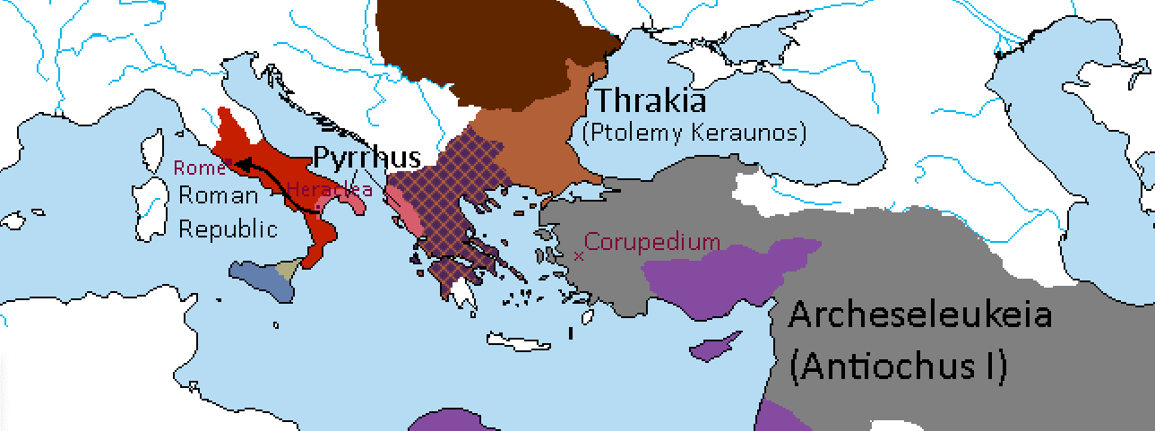
*Ptolemy Keraunos goes on to succeed Lysimachus in Thrakia.
281 BCE
Battle of Corupedium: Seleukos kills Lysimachus in battle but is assassinated by Ptolemy Keraunos. He is succeeded by his son Antiochus.
Pyrrhus defeats the Romans at Heraclea and goes on to besiege Rome itself.

Slide 17
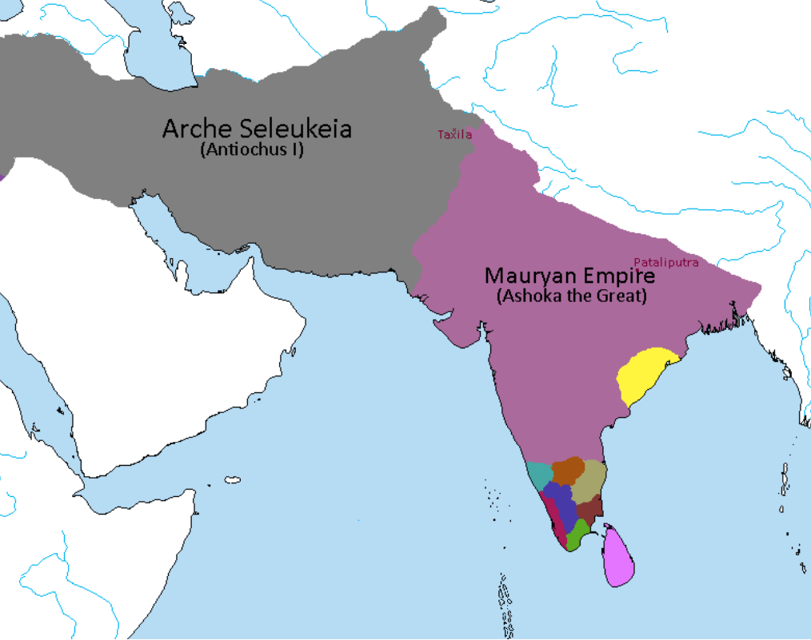
280 BCE
Beginning of the Mauryan Rebellion against Seleukid control in Sindhia.
Bindusara is killed in the Battle of Taxila. His son Ashoka is coronated in Pataliputra.

Slide 18
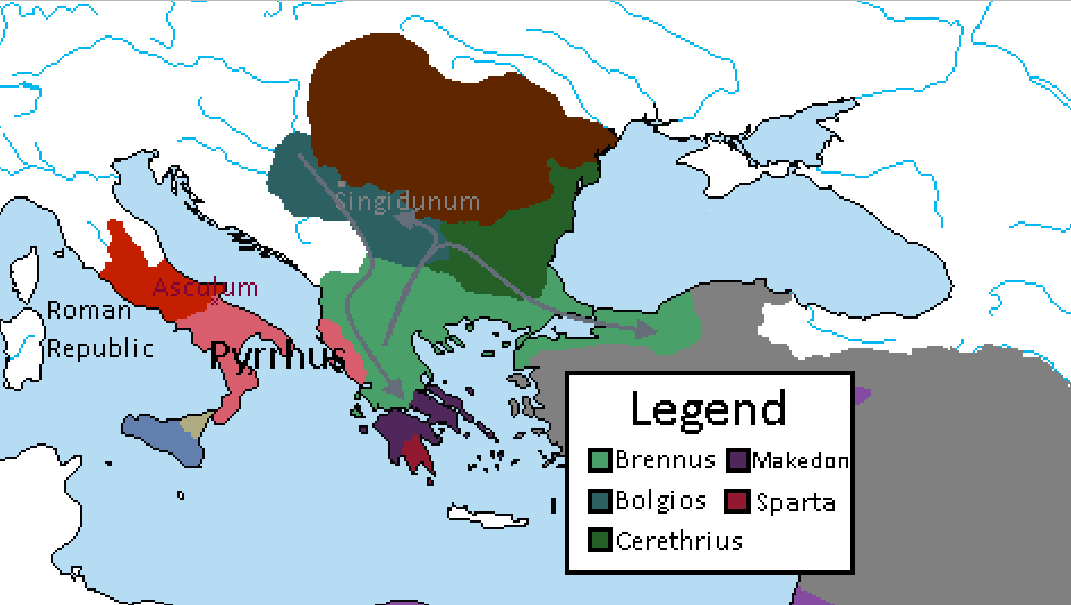
279 BCE
A Celtic army under Brennus invades Greece. They defeat a Makedonian army under Ptolemy Keraunos, but the Spartans temporarily hold Brennus at Thermopylae. Brennus retreats to the north only to defeat the pursuing Spartans in a battle near Mount Othrys. He then presses on and conquers Delphi, before retreating northwards.
The Celtic hosts splits, and a Celtic Kingdom of Tylis is founded under Cerethrius. Part of the host moves northwards to establish a kingdom in Pannonia, under Bolgios. Celtic Singidunum is founded. Brennus crosses the Hellespont and overruns Bithynia.
Pyrrhus defeats the Romans at Asculum. Peace is negotiated, with Rome acknowledging his dominion over Magna Graecia.
* ”Makedon” here is simply a term for Antigonus II Gonatas’ rump state in Greece. He is not presently recognized as a king, though he does still “wear the purple”.

Slide 19
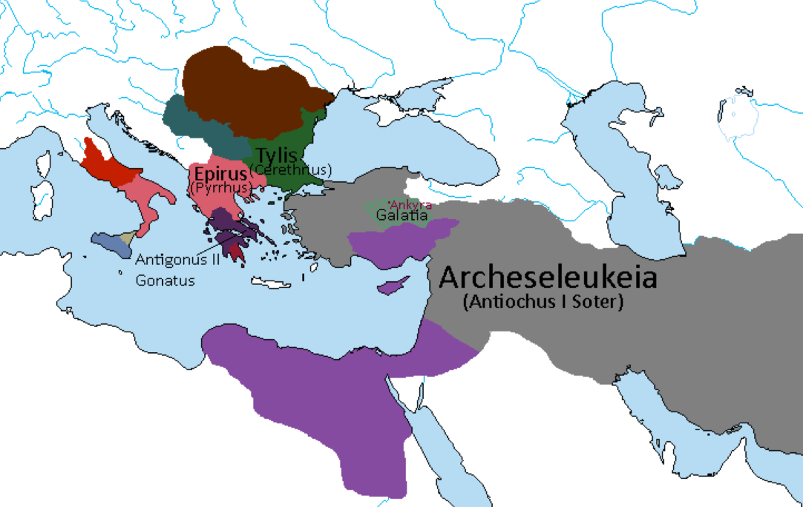
278 BCE
Brennus is defeated by Antiochus Soter near Ankyra. He acknowledges Seleukid sovereignty, and the majority of his Celts are settled in Galatia; many of the Celtic warriors take up service with the Seleukid Basileus.
Beginning of Seleukid policy of establishment of Celtic military colonies, from Asia minor to Bactria and Sindhia.
* No historical or canon references to Seleukid gains in Europe. Antigonus II historically regains his lands before losing most of them to Pyrrhus.

Slide 20
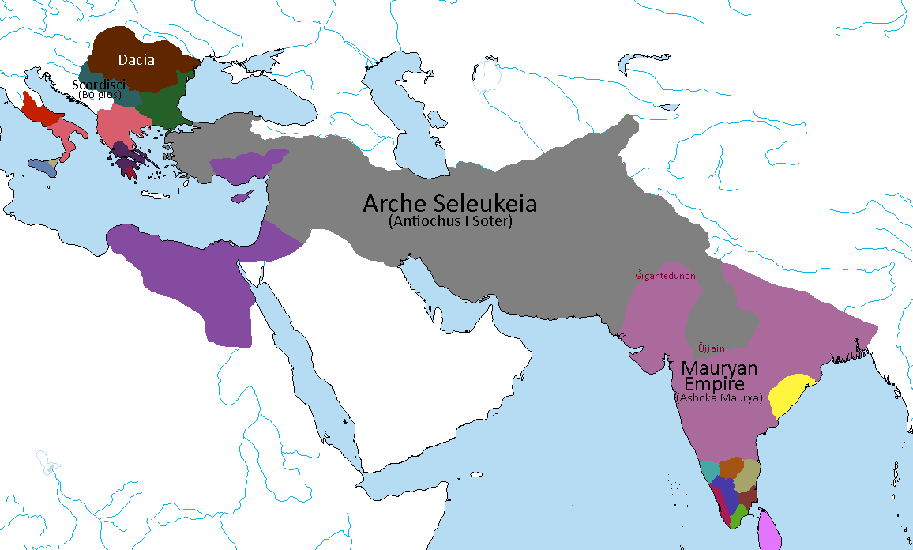
277 BCE
Daco-Celtic War, following Scordisci invasion of Dacia. Defeated, Bolgios King of the Scordisci marries Darava, the daughter of the Dacian King and retires to Singidunum. Beginning of the Daco-Celtic alliance.
Seleukid victory at the Battle of Ujjain, though a pyrrhic victory at that. Antiochus I Soter reaches Sindhia with his army composed of Hellenic and Celtic troops. Celtic town of Gigantedunon (“stronghold of giants”) founded across from Alexandria on the Indus.

Slide 21
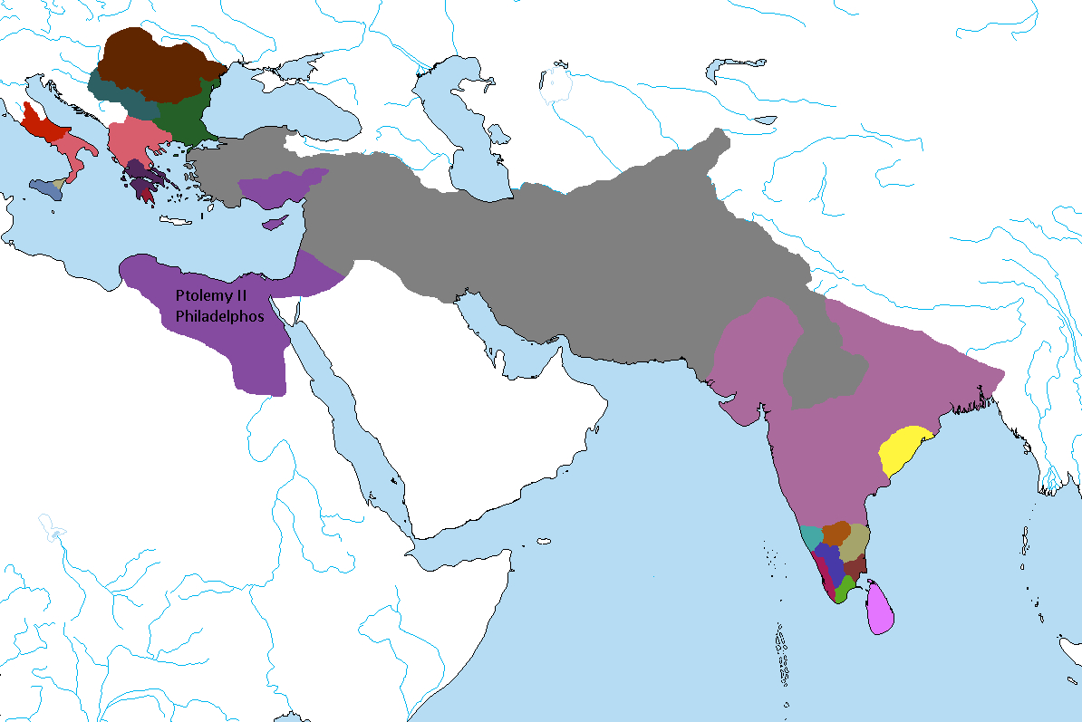
276 BCE
Ptolemy II marries his own sister Arsinoe. They become known as Philadelphoi (“sibling-lovers”).

Slide 22
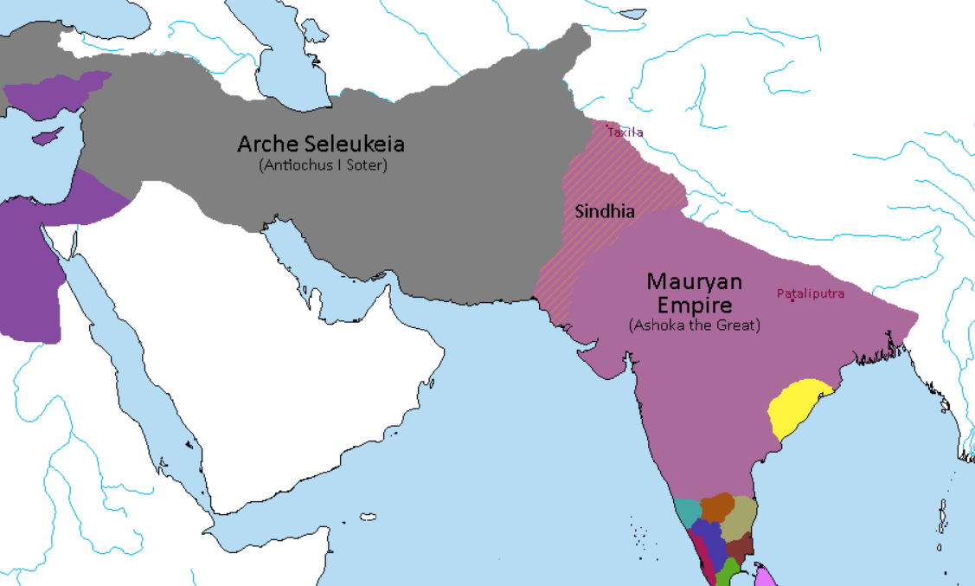
273 BCE
In exchange for land and titles in the Indus Valley, a handful of Seleukid generals defect to the Mauryan army in secret. They wait for a major battle to show their treason.
Ashoka the Great defeats the Seleukids in battle near Pataliputra.
Following the Treaty of Taxila, the “Great Satrapy of Sindhia” becomes subject to his direct rule. He marries the Seleukid princess Olympia as part of the peace negotiations.
CHANGES: Shaytana had written that Ashoka was already Satrap of Sindhia, and that “Eastern Sindhia” became quasi-independent. This implies the Mauryan Rebellion wasn’t already in progress, and that Sindhia had been divided. To alleviate confusion, I changed Ashoka’s title before the treaty but kept the result the same: one Sindhia, ruled by Ashoka.

Slide 23
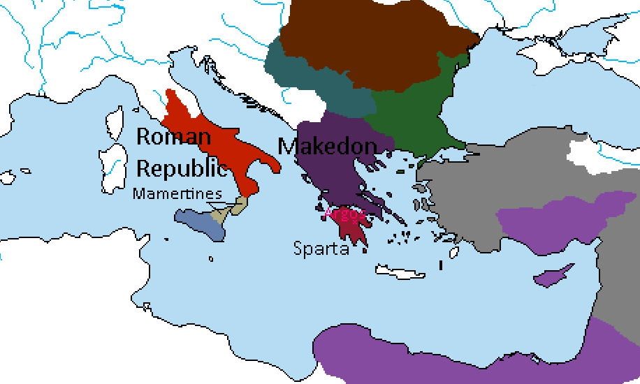
272 BCE
The Spartans under Areus I defeat Pyrrhus at the Battle of Argos, and Pyrrhus is killed.
Areus I is proclaimed King of the Hellenes, while Antigonus II Gonatas manages to regain the Makedonian throne.
Following the Treaty of Corinth Antigonus II is acknowledged as King of Makedonia, while Sparta retains the entire Peloponnesus.
*Epirus is absorbed into Makedon, while most of Pyrrhus’ holdings in Italy surrender to Rome. The Mamertines claim Rhegium and the Brutii region at the end of the peninsula.

Slide 24
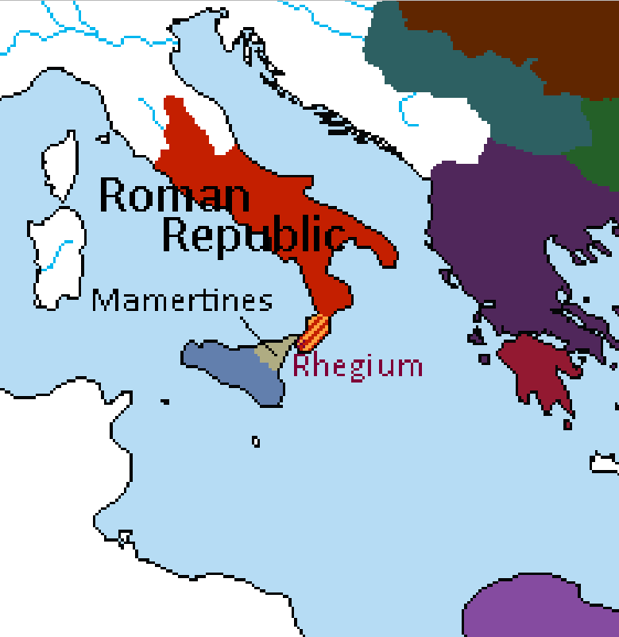
270 BCE
Romans drive out the Mamertines from Rhegium and restore it to its Greek citizens.
Mamertines retreat to Sicily.
*When Rome restores Rhegium “to its Greek citizens”, this is interpreted more culturally than politically. Whoever is ruling the city directly would ultimately be subject to Rome after this event.

Slide 25
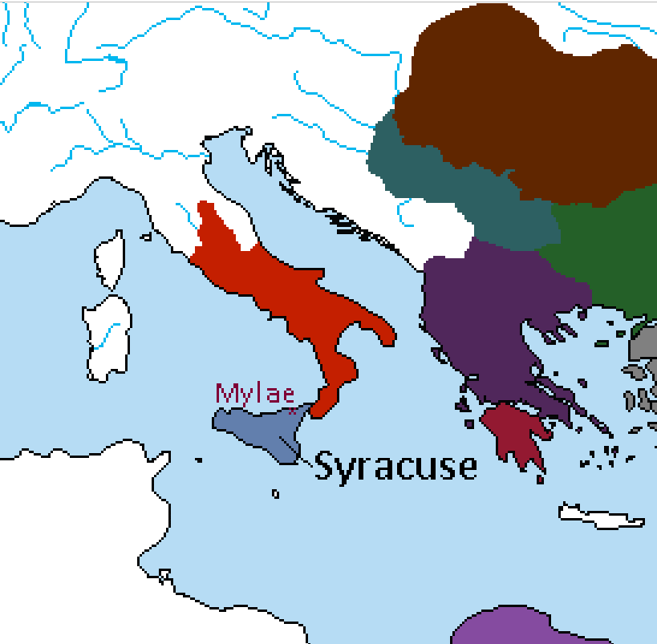
269 BCE
Hieron II of Syracuse defeats the Mamertines near Mylae. The defeated Mamertines accept his sovereignty and Hieron II becomes king of the entire island.

Slide 26
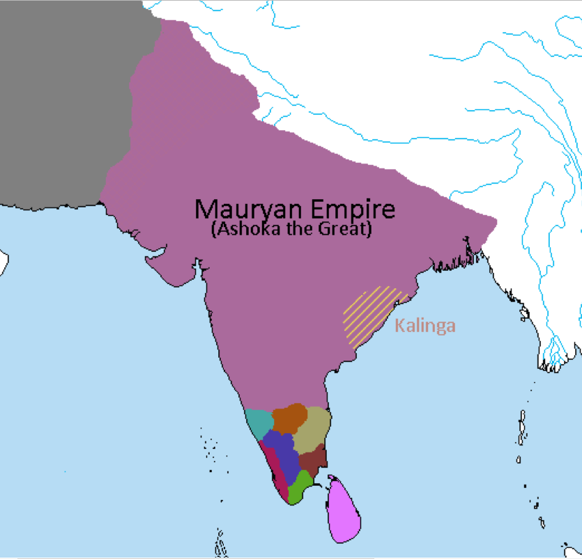
265 BCE
Kalinga is conquered by Ashoka the Great.
Ashoka is mortified by the death toll after the Battle of Kalinga. Over one hundred thousand lay dead and the rivers ran red with blood. Ashoka embraces Buddhism and begins a more peaceful, benevolent reign.

Slide 27
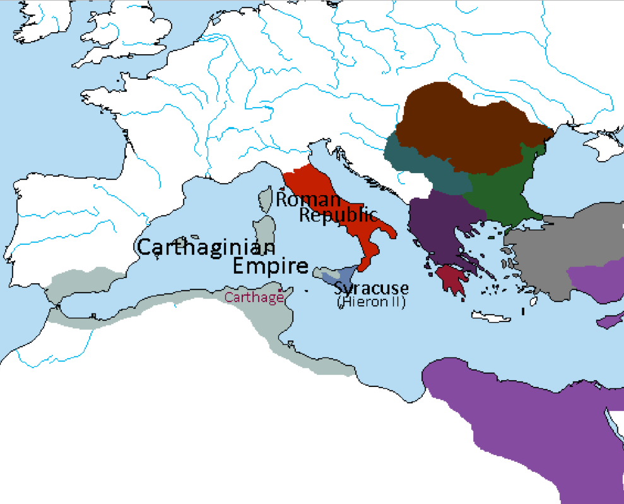
264 BCE
Carthaginians invade Sicily. Hieron II asks for Roman support.
Beginning of First Punic War. Hieron II acknowledged as King of Sicily by the Romans. Beginning of the Roman-Syracusan Alliance.
*By now, Rome has conquered the Etruscans and has most of the Italian peninsula under its control.

Slide 28
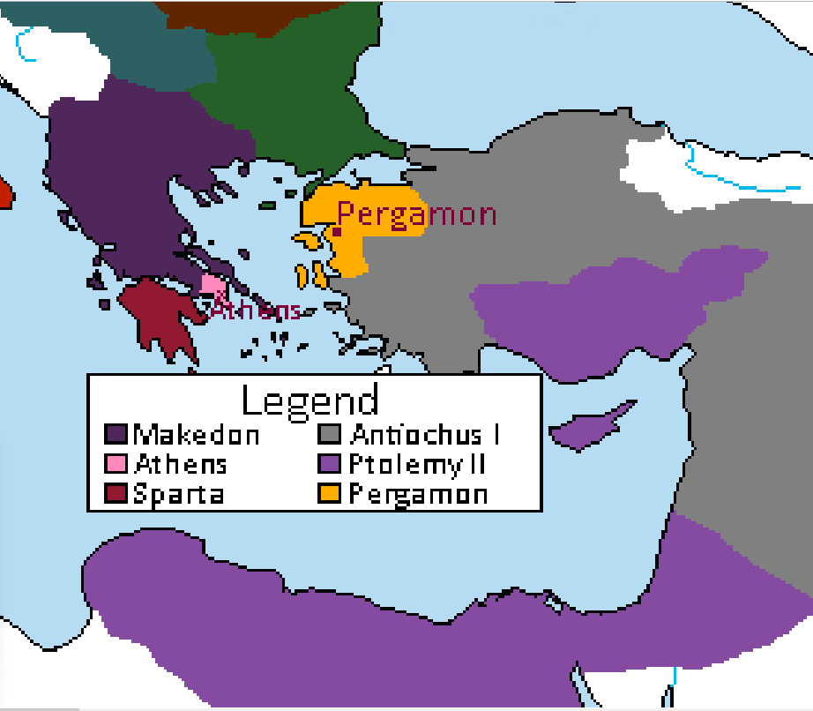
262 BCE
Supported by the Ptolemaic navy and army, Athens rebels.
Antigonus tries to besiege the city but is defeated and forced to acknowledge an independent Athenian state.
Eumenes I of Pergamon defeats Antiochus and founds an independent kingdom.

Slide 29
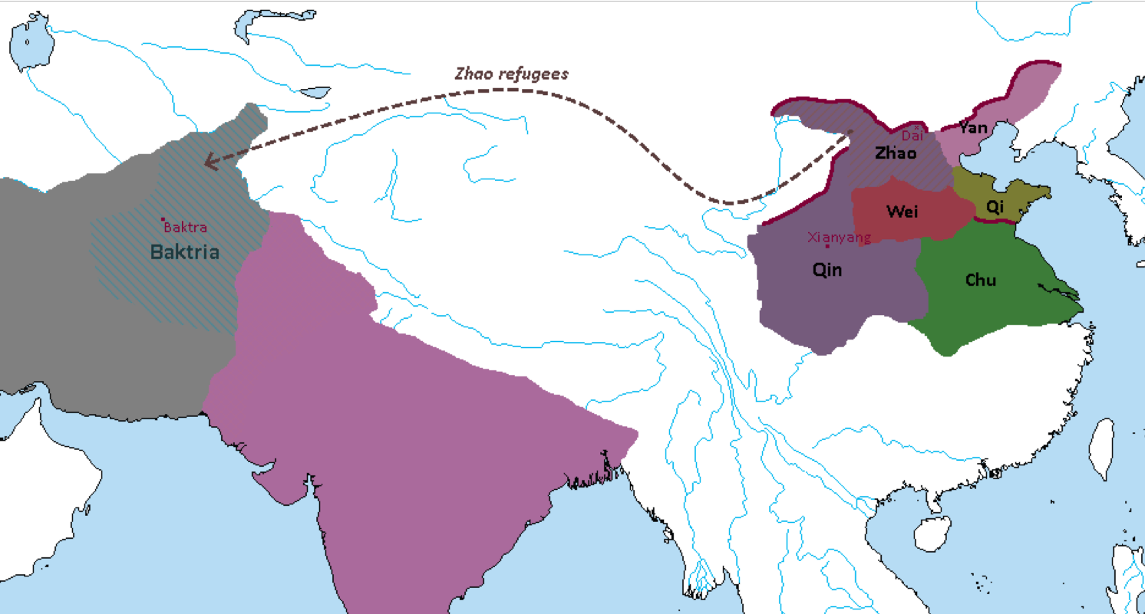
260 BCE
Qin overruns the state of Zhao.
The Great Western Exodus follows with several hundred thousand Zhao citizens migrating west, eventually settling in Central Asia and Baktria where they become Hellenic subjects.

Slide 30
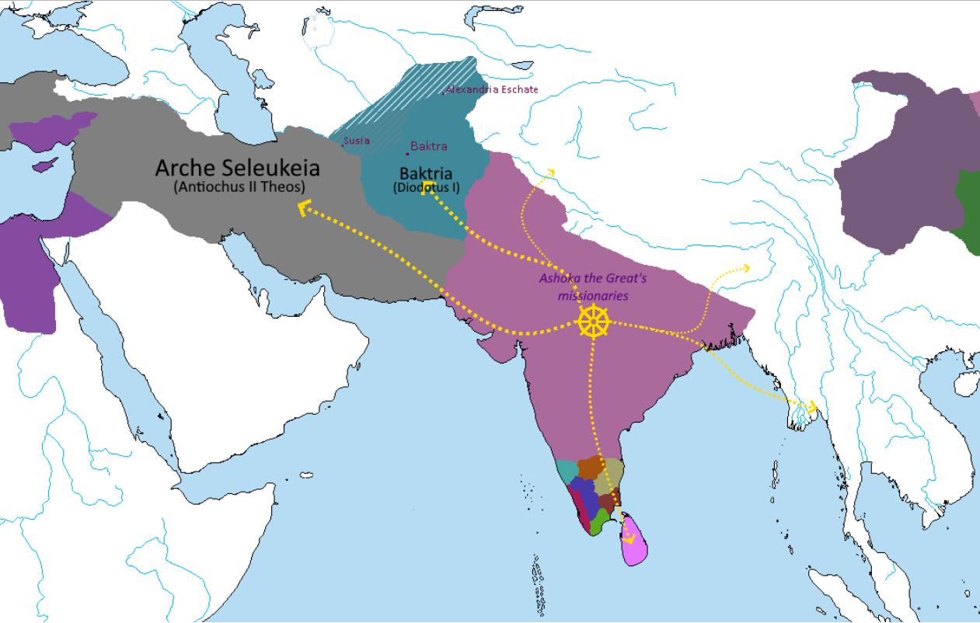
255 BCE
Diodotus, Satrap of Baktria, rebels and establishes an independent kingdom. His dominions are expanded with the help of the Zhao refugees and Galatian military colonies.
Ashoka the Great sends Buddhist missionaries in all directions, particularly towards the Hellenistic satrapies in the west.
Buddhism starts to become the dominant faith of India.
*Sri Lanka is the main hotbed of Buddhism in the south of India. Most of Tamilakam keeps their Brahmanical beliefs, although several Buddhist stupas and viharas are erected there.
**In the Far East, Qin has grown slightly; the Warring States period in Lux Invicta happens earlier than it does in our timeline.

Slide 31
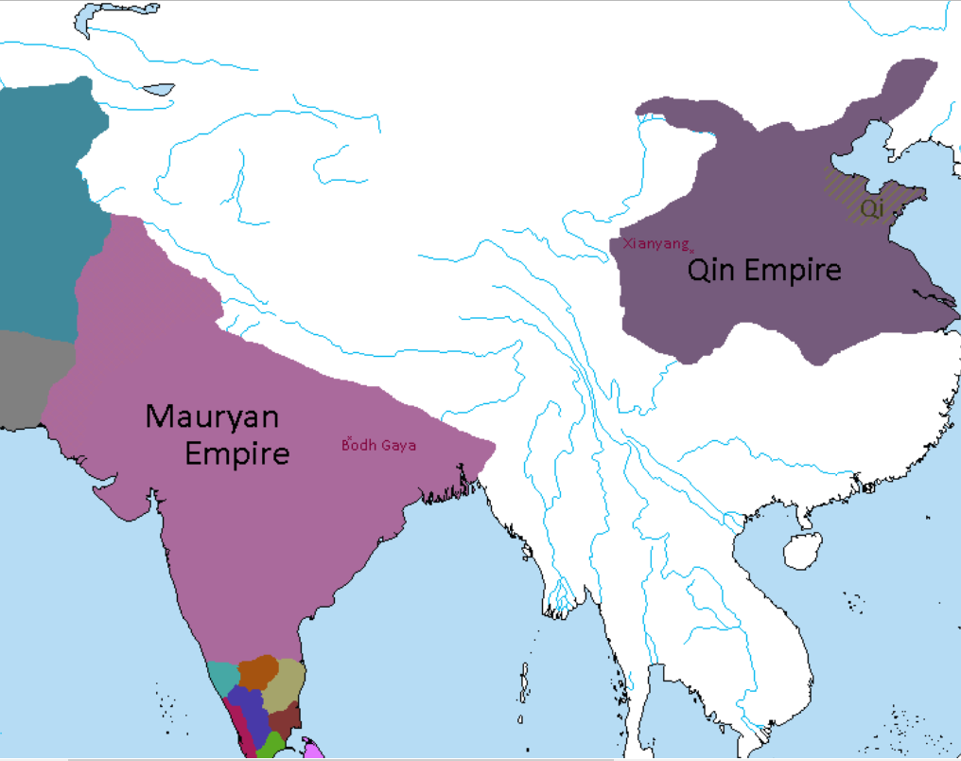
250 BCE
Ashoka the Great constructs a temple and the Diamond Throne at Bodh Gaya where the Buddha was said to have attained enlightenment.
The nine-year-old King Zheng of Qin accepts the unconditional surrender of Qi, completing the unification of China. He is coronated Qin Shi Huang (“First Emperor of Qin”) in his capital of Xianyang.
End of the Warring States period and beginning of the Qin dynasty.
*For age-related reasons, Qin Shi Huang did not conquer the other states on his own – though he did study closely under his regent Lü Buwei.

Slide 32
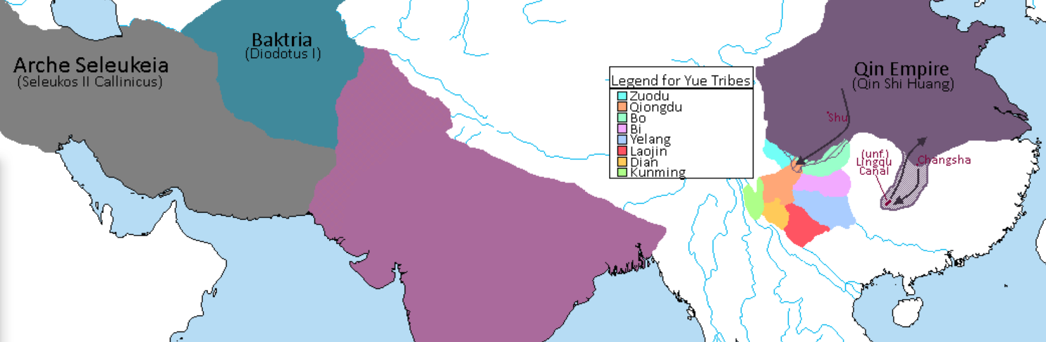

246 BCE
Diodotus marries the sister of Seleukos II Callinicus as his dominion over Baktria is confirmed.
Qin Shi Huang attempts to invade the Yue tribes south of Sichuan but suffers heavy losses against the guerrilla tactics used by the Yue soldiers.
Qin eventually withdraws, but not before beginning construction of a canal connecting the Yellow and Pearl river systems.
*Qin makes minor gains in Sichuan which they keep.
**The tribes in the area of the Lingqu Canal are not a unified kingdom yet, but this will eventually happen with the Nanyue during the Han dynasty.

Slide 33
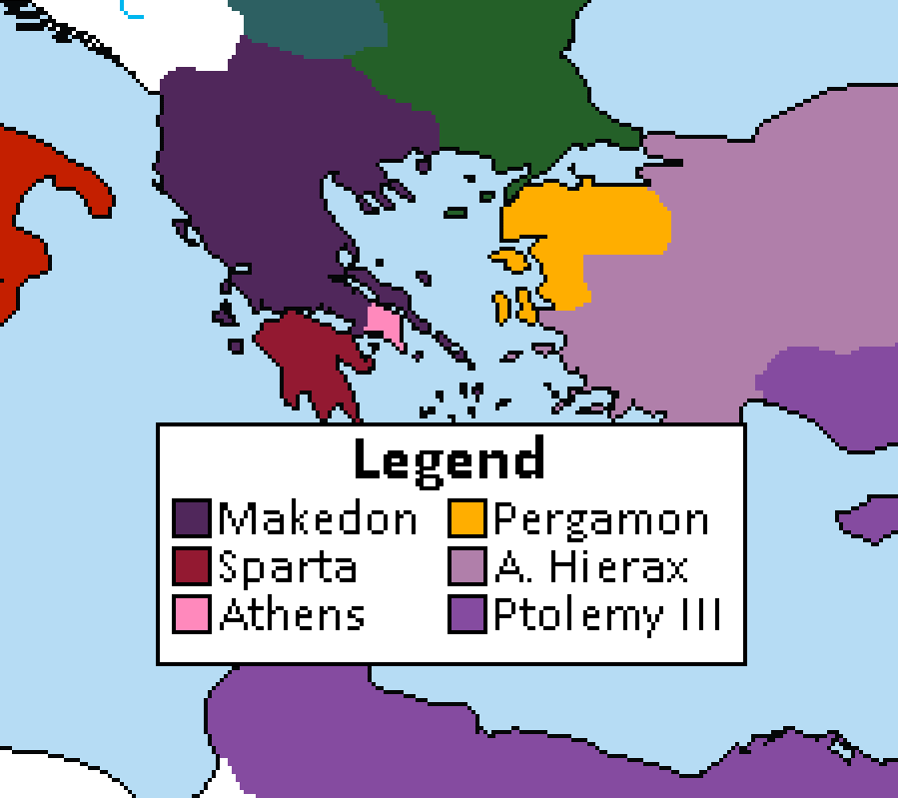
*Ptolemy II lost lands in Asia Minor to the Seleukids in the Second Syrian War. He also died in 246 BCE and was succeeded by Ptolemy III Euergetes without incident.
**While Seleukos II was occupied fighting Ptolemy, his brother Antiochus Hierax declares himself King of Syria in 245 BCE and claims Asia Minor for himself. Seleukos II has no choice but to accept… for now.
243 BCE
Agis IV reforms the Spartan state under a new Lycurgan model. The entire Peloponnesus is turned into a militaristic state, with all Hellens gaining citizenship and with all young men being enrolled into the new Agoge system.
A defensive alliance is formed with the Athenians against potential Makedonian invasion.

Slide 34
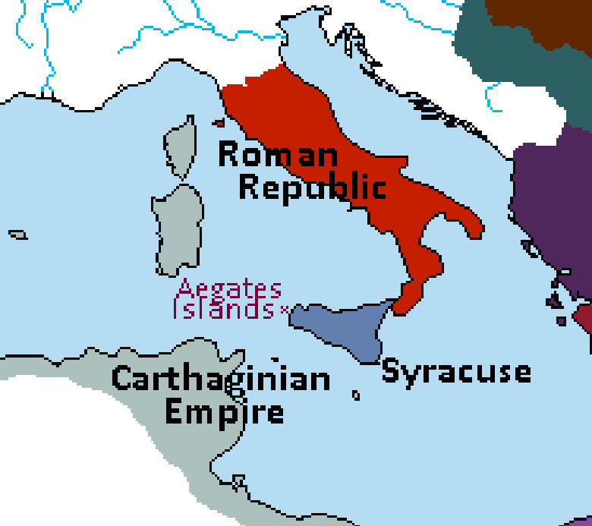
241 BCE
Carthage is defeated by the Roman-Syracusan alliance in the Battle of the Aegates Islands.
The First Punic War ends, Carthage renouncing all its claims on Sicily. Syracusan dominion of Sicily is confirmed.
An Eternal Alliance Treaty is signed between Rome and Syracuse, and a Roman legion (supported by Syracusan taxes) is stationed in Sicily.

Slide 35
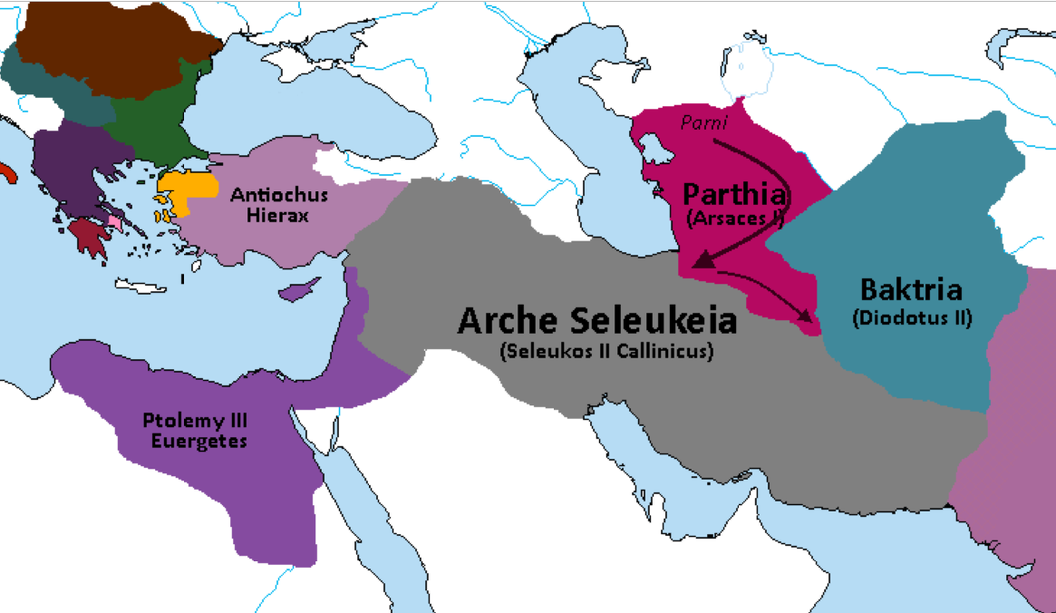
237 BCE
The Parni King Arsaces invades and conquers the Seleukid Satrapy of Parthia.
Seleukos II Callinicus is taken prisoner.
*It also stands to mention that Ptolemaioi made gains against the Seleukids in the Third Syrian War, retaining Ephesos and Seleukeia Pieria near Antiocheia. This will ultimately be the main cause of the Fourth Syrian War in 219 BCE.

Slide 36
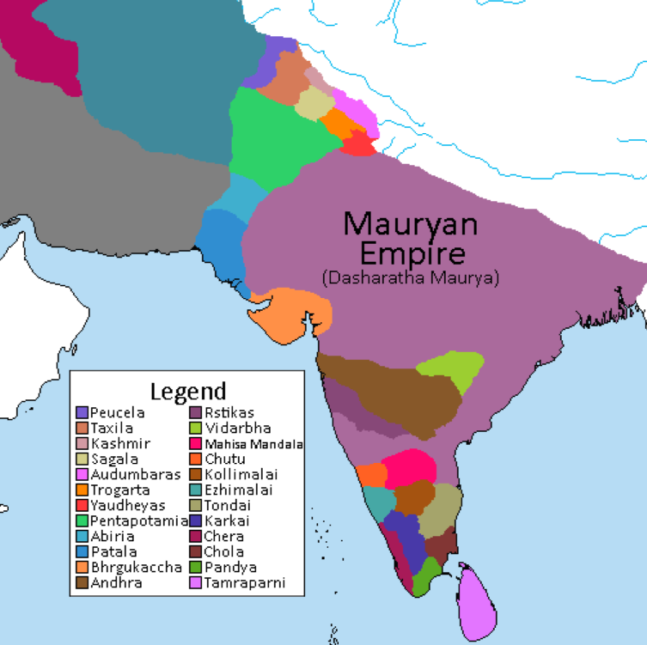
232 BCE
Ashoka the Great is ambushed by Hindu fanatics and drowned in the Ganges River.
The empire falls into chaos as several kings in central and southern India and all the Hellenic satraps in Sindhia declare independence. His son and heir Dasharatha struggles to restore order.

Slide 37
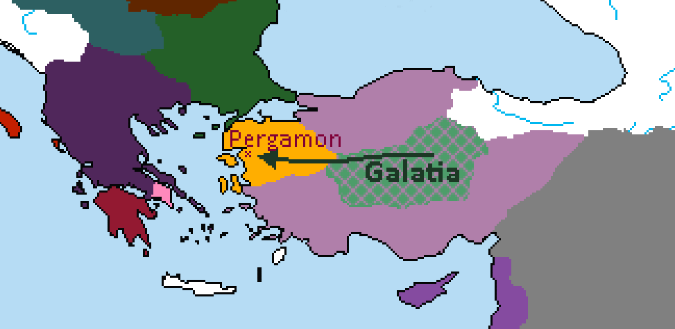
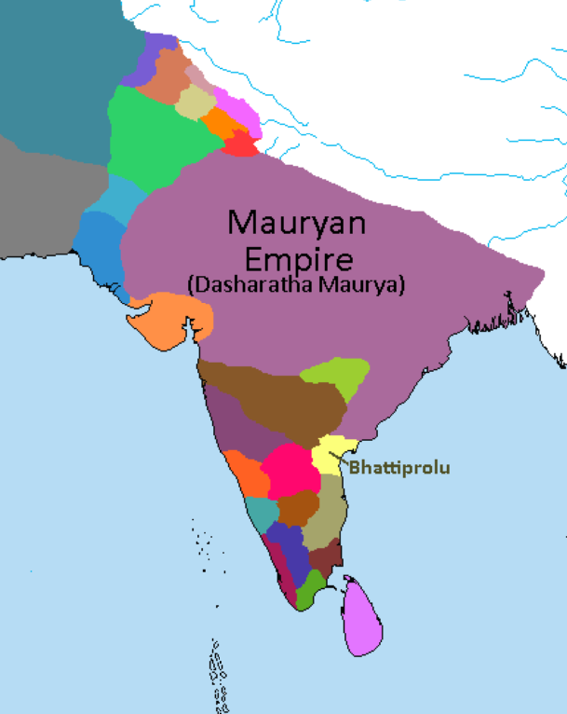
*In Egypt, Ptolemy III builds the Temple of Horus, boosting the influence of ancient Egyptian religion within his empire.
**The Roman navy occupies the island of Corfu in an effort to curb Illyrian piracy on their trade fleets. This does not result in war with Makedon, as the island had been previously taken by Illyrian pirates and its Greek inhabitants expelled.
230 BCE
Attalus I Soter of Pergamon defeats the Galatian invasion of Pergamon. He marries the Galatian princess Berena and an alliance is formed between the Galatians and Pergamon.
King Kubera of Bhattiprolu joins the rebellion against the Maurya. The resulting geographic isolation allows rebel factions to consolidate power in Karnataka.

Slide 38
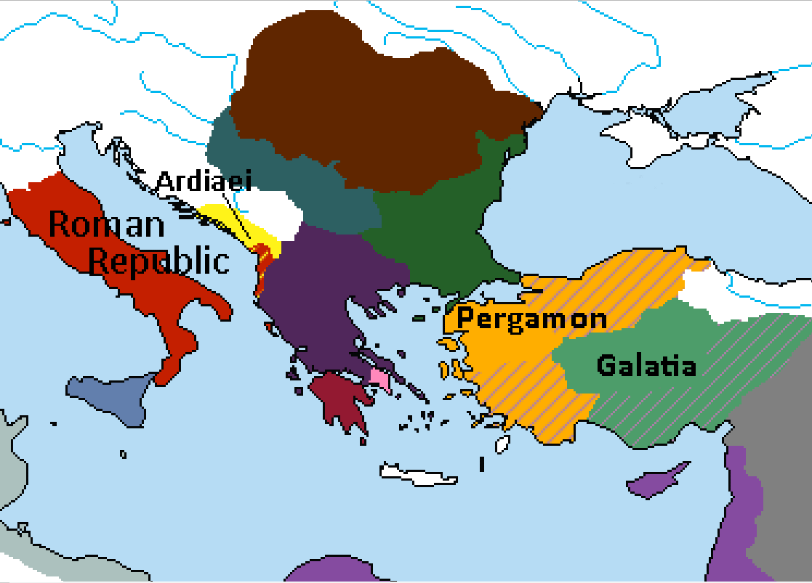
228 BCE
Attalus I Soter and his Galatian allies defeat Antiochus Hierax near Tarsus. Anatolia and Cilicia are divided between Attalus and his allies.
*In Illyria, Rome has landed in Apollonia and now besieges the Ardiaei capital of Shkodra.

Slide 39
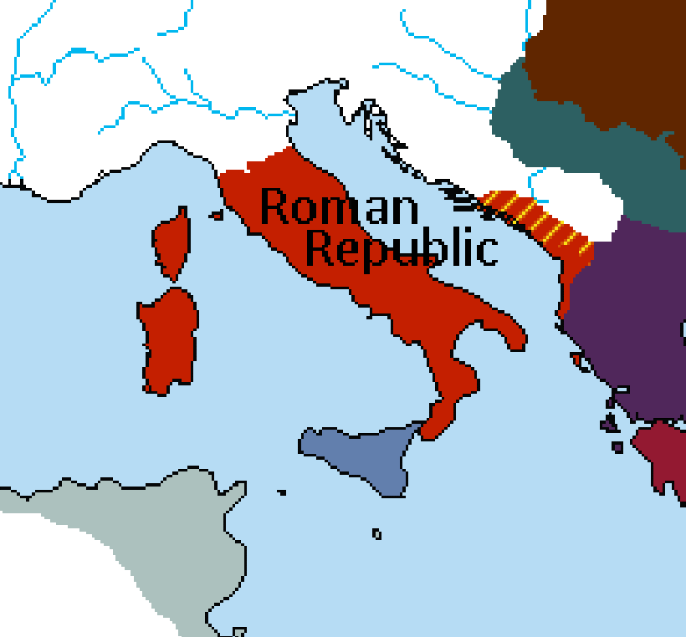
* “Illyria” here refers to the Kingdom of the Ardiaei; the rest of the Dalmatian coast and inlands are still largely under Celtic and Venetic influence.
**Sardinia and Corsica were annexed by Rome around 237 BCE after their rebellion from Carthage during the Mercenary War.
227 BCE
Queen Teuta of Illyria acknowledges Roman overlordship.
Illyria becomes a client kingdom of Rome.

Slide 40
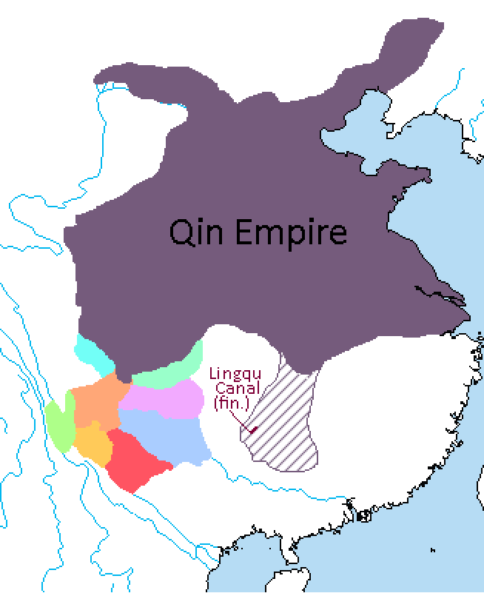
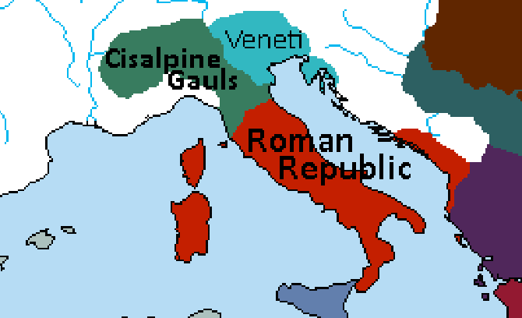
225 BCE
A renewed Qin offensive led by Wang Ben into Yue territory results in the completion of the Lingqu Canal. Wang Ben is made King of Lingling, which is incorporated into the Qin Empire.
*In Italy, a confederation of Gallic tribes crosses the Alps and pillages Roman settlements in Etruria. The Romans call on these Gauls’ historic enemies, the Veneti, and begin driving them towards the coast of Tuscany.

Slide 41
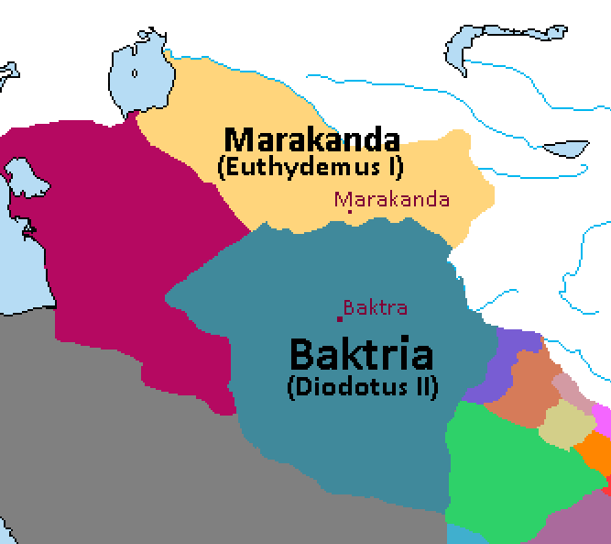
*Historically, Euthydemus kills Diodotus II in 225 BCE and succeeds him to the Baktrian throne. Considering it is Diodotus III who invades Marakanda 40 years later, it’s safe to assume Diodotus II is still alive at this point and will probably die in battle against Euthydemus in the near future.
**Also, the Aral Sea didn’t dry up until the Soviet era, please disregard any previous images showing modern sea levels.
223 BCE
Euthydemus I, Satrap of Sogdiana rebels against his Baktrian overlord Diodotus II, founding a great Hellenistic kingdom centered around Marakanda. Part of his army is composed of Helleno-Zhao troops.

Slide 42
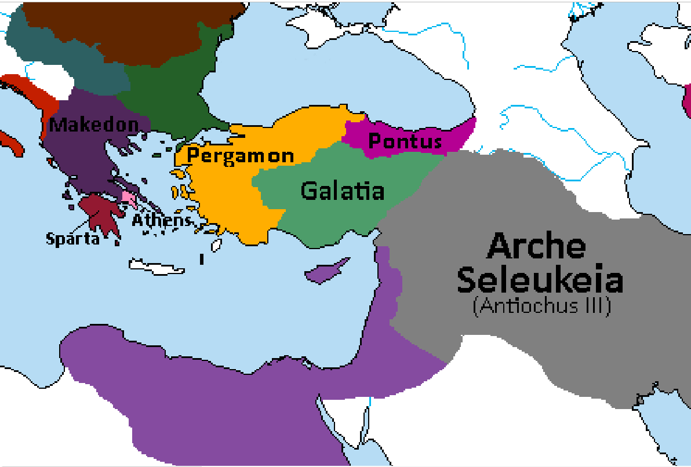
222 BCE
Antigonus III of Makedon attacks Athens but is defeated by a Spartan-Athenian coalition in the Second Battle of Marathon.
Antiochus III marries Laodice the daughter of Mithridates II of Pontus and an alliance is formed against Pergamon and the Galatians.

Slide 43
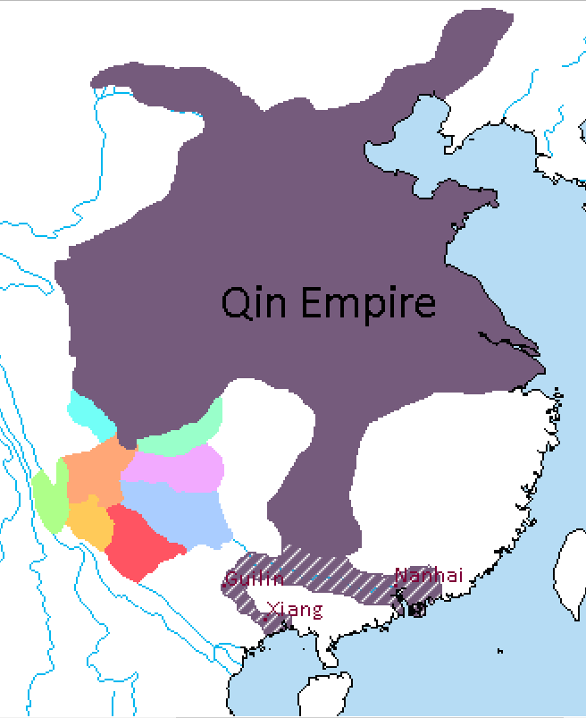
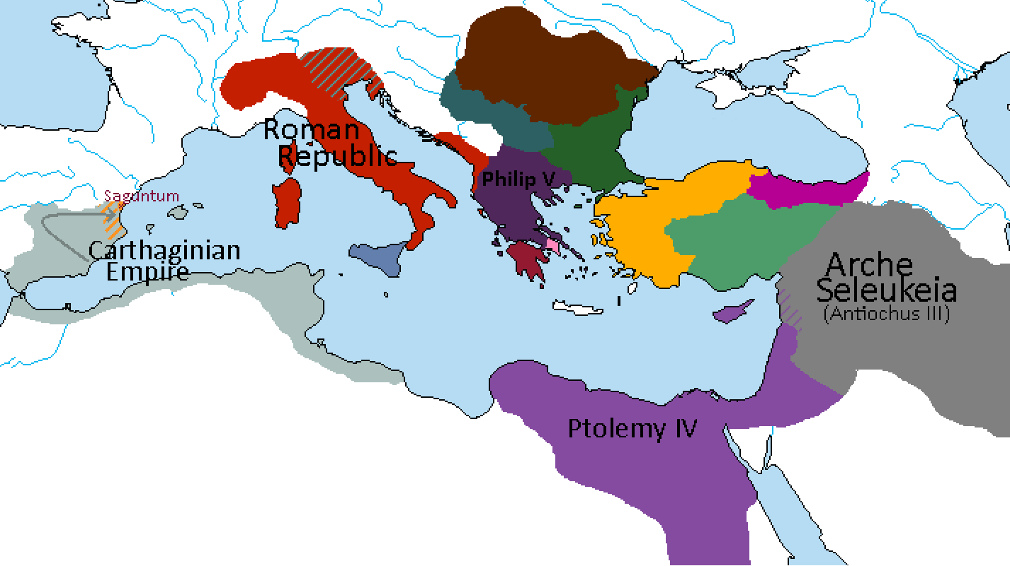
219 BCE
Hannibal besieges Saguntum, an ally of Rome. Beginning of the Second Punic War.
Qin forces expand into Guangdong. Nanhai Commandery is established with its capital at the mouth of the Pearl River.
Qin Shi Huang appoints his general Zhao Tuo as magistrate for the region.
*Ptolemy III Euergetes has been succeeded by Ptolemy IV, who is under complete influence of his regent Sosibus. Many of his own family are executed under his orders. He also marries his sister Arsinoe III.
**Antigonus III died in battle against the Illyrians and is succeeded by his cousin Philip V.
***Illyrians attack Roman settlements in Greece, triggering the Second Illyrian War. Rome’s interference here is the main cause of the First Makedonian War.
****Rome completes the conquest of the Veneti, leaving Liguria the only part of the Italian peninsula not under Roman control.
*****Antiochus III has successfully put down revolts in Mesopotamia and now turns his attention to Ptolemy IV’s lands in Syria. Beginning of the Fourth Syrian War.

Slide 44
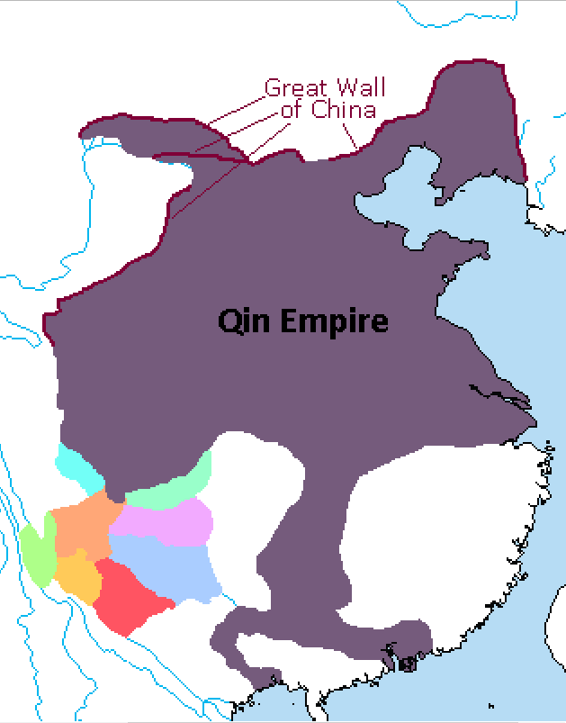
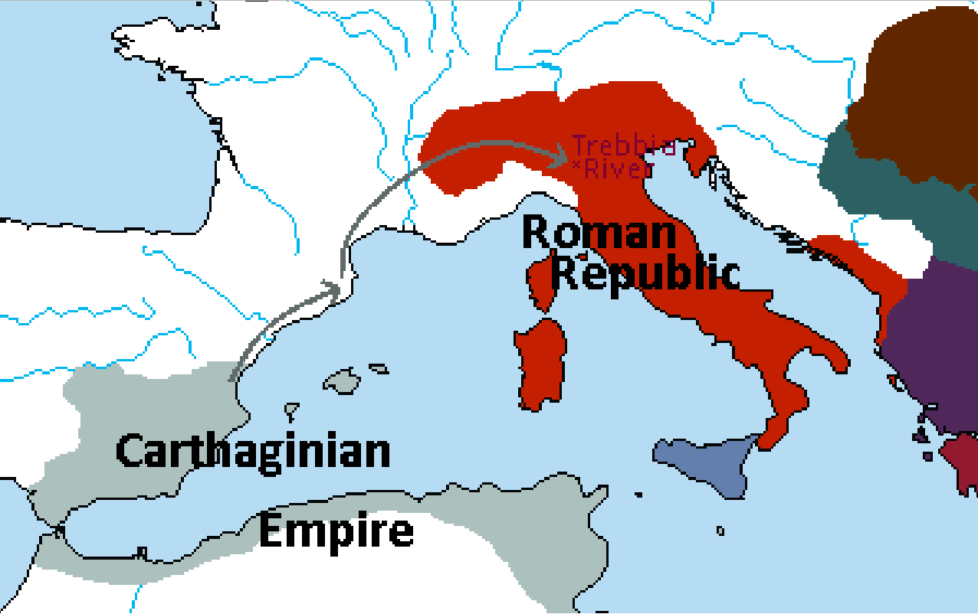
218 BCE
Qin Shi Huang orders the reconstruction of the Great Wall, surpassing the former in size.
*This is also when Hannibal’s legendary crossing of the Alps occurs, with 40,000 troops and 50 elephants attempting the trip. The same year (in winter no less) they arrive in the Po Valley and defeat the Romans at the Battle of the Trebia.

Slide 45
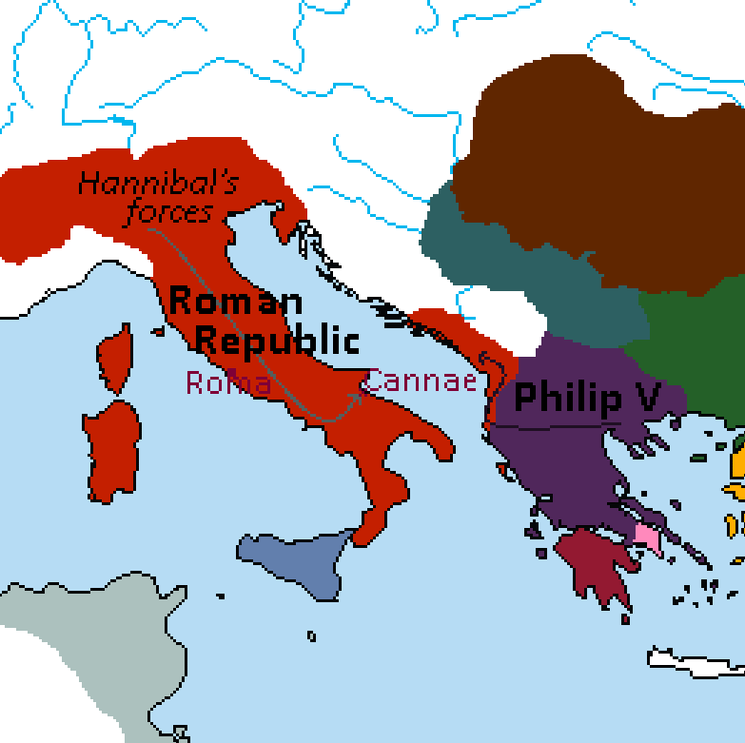
216 BCE
Philip V of Makedon invades the Roman client state of Illyria. Beginning of the First Makedonian War.
Hannibal defeats the Romans at Cannae.

Slide 46
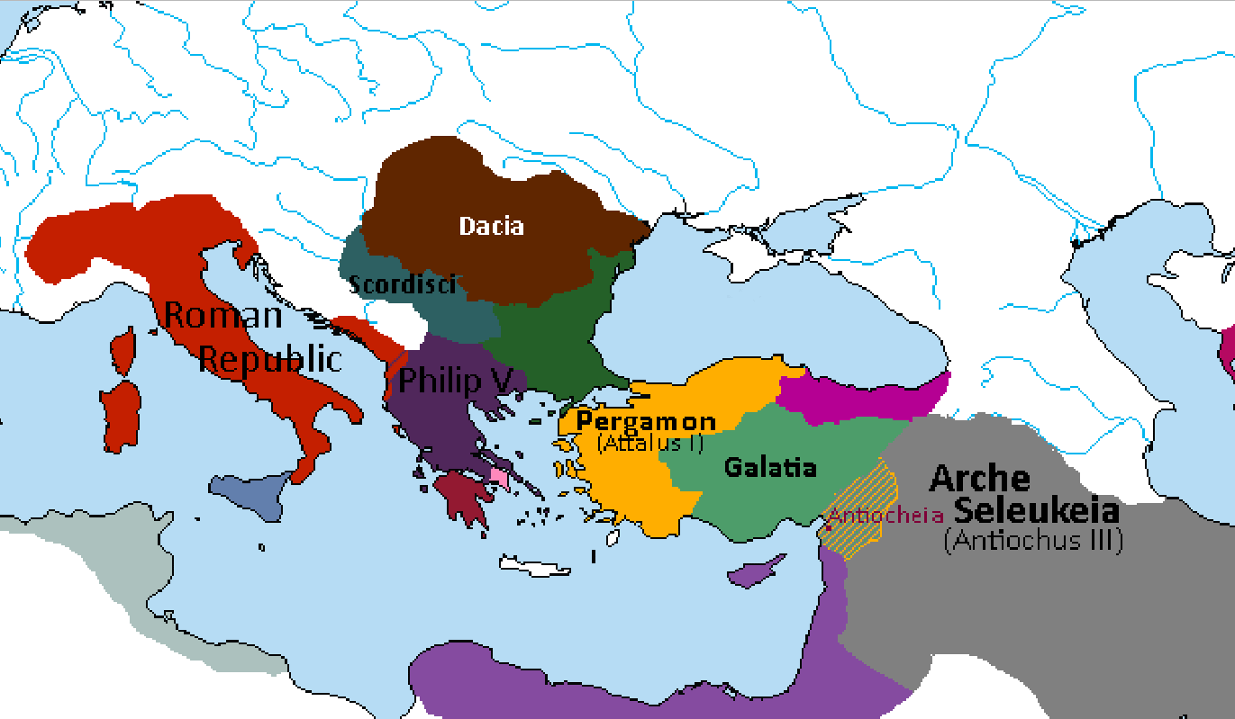
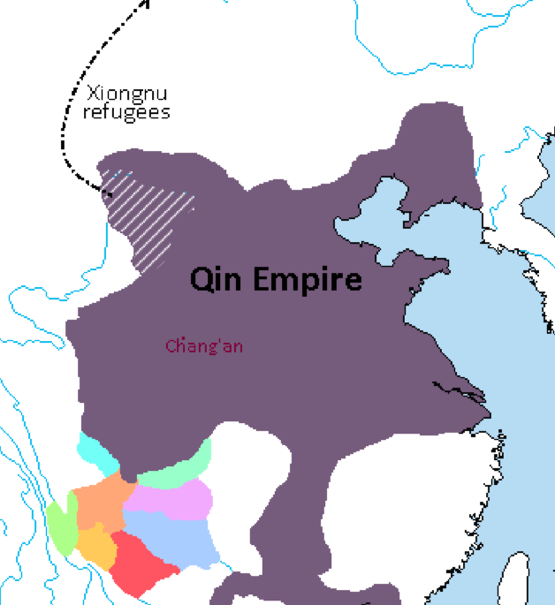
*At this time, Hannibal and Philip V have also made an alliance, although Hannibal reserves the right to make peace with Rome at any time in exchange for Makedonian sovereignty over Illyria as part of the negotiations.
**The Xiongnu will eventually consolidate into a confederation led by Modu Chanyu in 209 BCE.
***Qin Shi Huang constructs the Terracotta Army in Chang’an.
215 BCE
Attalus I Soter of Pergamon occupies Antiocheia. Antiochus III sues for peace and acknowledges Attalus's conquests and regains Antiocheia in the following peace treaty.
Philip V, with the help of his Dacian and Scordisci allies defeats a Roman army near Apollonia in Illyria.
A Qin army drives the Xiongnu from the Ordos Plateau. The refugees cross the Yellow River and move northward, reorganizing with other Xiongnu tribes in the area.

Slide 47

213 BCE
Qin Shi Huang orders all Confucian writings destroyed. Beginning of Legalist era in China, marked by absolute power invested in the head of state and the widespread persecution of scholars.
Renewed Chinese emigration to Hellenistic Central Asia as Confucian scholars find refuge in Marakanda.
Qin forces conquer the Luoyue kingdoms around the Red River Delta. Zhao Tuo is appointed King of Lingnan by Qin Shi Huang.
*The city of Panyu is founded near the mouth of the Pearl River.

Slide 48



212 BCE
The Celtic Kingdom of Tylis allies with Rome against Philip V of Makedon.
Syphax, Numidian King of the Masaesyli, allies himself with Rome against Carthage.
Antiochus III invades India and establishes Seleukid control over the region. His campaigns reach Sri Lanka, and he is proclaimed “Megas” by his troops following the utter destruction of the army of a coalition of Tamil kingdoms in the Battle of Suvarnagiri.
Meanwhile in the west, his sister Antiochia is married to King Xerxes of Armenia.
*Xerxes is King of Armenia Minor (Mikre Armenia); his brother Orontes IV of Armenia Major (Megale Armenia) was deposed and killed by Antiochus III, and his realm divided between the generals Artaxias (Megale Armenia) and Zariadres (Sophene). Xerxes avoided this fate by marrying a Seleukid princess. It also stands to mention that these parts of Armenia have been Seleukid vassals for some time, and this is a largely internal affair in retribution for previous rebellions in Mesopotamia.
**Historically, Antiochus III spent the last decade fighting Ptolemy IV and putting down rebellions in Anatolia. But in Lux, Anatolia has been left to the Pergamenes and Galatians. Ptolemy IV is too busy putting down Egyptian revolts to be a threat, so Antiochus spends the last few years preparing to invade India. Being weakened from the internal fighting, no one army or coalition is strong enough to resist a massive foreign invasion, and the subcontinent falls to the Seleukids.
***Kashmir and the Audumbaras retain independence in exchange for an alliance with the Seleukids.

Slide 49

211 BCE
Sparta, Athens and Pergamon join Rome in their war against Philip V of Makedon.
Megas Antiochus III commissions an explorer named Patrocles to find a route to China over the Himalayas. His small expedition is composed mainly of northern Indians and Tibetans.
*Hannibal still campaigns in Italy, and Roman defeats in Hispania have created a bleak situation for the Roman Republic.
**With the help of his Celtic allies, Makedon has captured most of Illyria from the Romans.
***Patrocles’ expedition ultimately fails after they cannot find a safe way across the Yellow River. Concluding there is no “middle route” to China, Patrocles returns to India.

Slide 50

Antiochus III conquers Hecatompylos, the Parthian capital, and defeats Arsaces II in the Battle of Mount Labus. Arsaces II is forced into an alliance with Arche Seleukeia.
Qin Shi Er deposes his vassal lord of Wei, which prompts his other vassals to rebel. The rebellion sees several former independent kings restored throughout the empire.
Modu Chanyu, Emperor of the Xiongnu pushes into China, renewed Chinese emigration towards Central Asia.
*The Yue tribes around the Red River secede from Lingnan.
209 BCE

Slide 51

208 BCE
Megas Antiochus III becomes titular overlord of Baktria and Marakanda, receiving the submission of their kings. Seleukid princesses married to the heirs of Baktria and Marakanda.
*Unlike Arsaces II, who was merely forced into an alliance, the Hellenic kings Diodotus III and Euthydemus I are directly subjugated, and their territories are annexed into the sprawling empire of Arche Seleukeia.

Slide 52

Publius Cornelius Scipio defeats the Carthaginians at Ilipa and drives them out of Spain.
Masinissa, the Numidian King of the Massylii, joins the Roman cause but is more concerned with fighting his fellow Roman ally Syphax.
*Historically, Syphax joins the Carthaginian cause, possibly as an excuse to depose Masinissa and rule all of Numidia. In Lux, Roman intervention prevents the kings from ousting one another; this behavior will become a hallmark feature of Roman foreign policy, both in our timeline and this one.
**The Mauri are a separate group of Numidians unaffiliated with the Romans, who opportunistically filled the vacuum left by Carthage.
206 BCE
(1 of 2)

Slide 53

206 BCE
(2 of 2)
Megas Antiochus’ begins his legendary campaign into China. His army consists of over half a million soldiers from all parts of the empire, including Greeks, Indians, Persians, Celts, Armenians, Parthians, and Chinese. Traveling along the Silk Road, they march as far as Wuwei by the end of the year.
Qin Shi Er is assassinated by his chief eunuch Zhao Gao. His nephew is coronated Emperor Ziying, whose first order of business is the assassination of Zhao Gao.
In the same year, a rebel general named Liu Bang captures Ziying, who surrenders the city of Xianyang without a fight, bringing an end to the Qin dynasty.
CHANGES: Shaytana had written that Antiochus III invaded China and established the city of Antiocheia Eschate all in one year, and then campaigned against the Han for four more years. The longest and most difficult part of the whole ordeal would have been the journey across desert and mountains into Western China and establishing a foothold once there. A year is simply not enough time, even for Megas Antiochus. The invasion has been broken up into smaller parts, with events from the Chu-Han Contention also being taken into consideration.

Slide 54



205 BCE
First Makedonian War ends with Philip V emerging victorious in the Second Battle of Apollonia. Large parts of Illyria are ceded to Makedon.
Philip V conquers Crete and attacks Rhodes.
Using his Han and Zhao soldiers as guides and translators, Megas Antiochus uses the ancient galley road system to cross into the Sichuan Valley and besiege the city of Chengdu. Beginning of the First Hellenic Invasion of China.
Liu Bang formally starts the Chu-Han Contention by attacking Pengcheng.
*The mercantile city-state of Gerrha historically avoids an invasion by Antiochus III by sending a large tribute of silver. Since Megas Antiochus is campaigning in China, this money is instead used to bolster their influence abroad in Persia and India.
**A native Egyptian uprising led by Horwennefer takes place in Upper Egypt against the new king Ptolemy V, whose father’s death had been kept secret until now for exactly this reason.
***For further clarification on the events in China, please read the expanded time for the Chu-Han Contention.

Slide 55

204 BCE
Nanyue Kingdom established by Zhao Tuo in south China/north Vietnam.
*Unlike Lingnan, which was established by the Qin, the Nanyue Kingdom is led by a local Yue administration and is rather detached (both physically and politically) from Chinese affairs. Zhao Tuo, originally from northern China, is still the King of Nanyue.
**Most of the Eighteen Kingdoms founded by Xiang Yu have been conquered or annexed by either Han or Chu, or else fallen to the foreign invaders.
***In the Mediterranean, Hannibal is forced to leave Italy and return to Africa after Publius Cornelius Scipio’s army besieges Utica. After several inconclusive battles, the Carthaginian and Roman armies are at a stalemate.

Slide 56


202 BCE
Philip V conquers Rhodes but allows the local Apollonios dynasty, who are the supposed descendants of Apollo, to remain in power as his clients.
Roman victory in the Battle of Zama. Hannibal is defeated by the Roman-Syracusan-Numidian coalition lead by Scipio, now receiving the surname Africanus. End of the Second Punic War, marking the decline of the Carthaginian state.
End of the Chu-Han Contention following the last stand and suicide of Xiang Yu at Gaixia.
Peace between Megas Antiochus and Liu Bang. Formation of the Great Seleukid Chinese Satrapy of Antiocheia Eschate. The city of Antiocheia Eschate is founded on the ruins of Chengdu.
Seleukos, son of Antiochus III, is made Satrap of Antiochia Eschate and left to govern while his father returns west.

Slide 57


201 BCE
Philip V conquers Chios and installs the Lysimachid prince Alexandros as a client ruler. He then invades Pergamon, despite a Roman ultimatum warning against it. Beginning of the Second Makedonian War.
Modu Chanyu defeats a large Han army at Baideng.
Liu Bang begins a new policy of appeasement known as “heqin”, with large amounts of tribute sent and several Chinese princesses being married off to Xiongnu chiefs.

Slide 58

*Makedon is forced to forfeit its holdings in Greece and the Aegean. Rome regains contemporary Illyria as the northern reaches fall back under the rule of various Celtic-Illyrian kingdoms. King Bato of Dardania is awarded independence for his help against the Makedonians, although relations with Rome sour shortly thereafter.
**After returning from China, Megas Antiochus III launched a campaign against Ptolemy V who is still struggling with revolts. Megas Antiochus wins the Fifth Syrian War and gains Syria and Palestine. He then invades Galatia and Pergamon on a katabasis to the Hellespont.
***Mithridates III of Pontus takes advantage of a weakened Pergamon and opportunistically seizes large parts of their northern holdings. Conquests cease after allied Megas Antiochus assures Bithynia’s independence, and in exchange Bithynia promises not enter into agreements with Rome.
****Attalus I Soter dies and is succeeded by his son Eumenes II in Pergamon.
197 BCE
Philip V marginally defeated at the Battle of Cynoscephalae. A peace is signed with Rome.

Slide 59


Megas Antiochus crosses the Hellespont into Europe. War with Rome. The exiled Hannibal arrives at his court.
Sparta and Athens, fearing Seleukid conquest, ally with Rome. A vast Hellenic coalition (including Philip V) joins with Rome against Megas Antiochus.
196 BCE
*The Celtic Kingdom of Tylis, longstanding enemy of Makedon, is happy to ally with Megas Antiochus and guarantee him safe passage in exchange for their own independence.
**On a side note, this is when parchment is invented in Pergamon as the result of a papyrus embargo by Ptolemy V.
***The Rosetta Stone is created by Ptolemy V in Egypt.
(1 of 2)

Slide 60

196 BCE
Liu Bang executes several vassal kings, accusing them of treason. Ying Bu of Huainan leads a rebellion in the south.
Liu Bang successfully leads a campaign to put down the rebellion but is wounded by an arrow in battle and later dies of infection. His wife Empress-Dowager Lü Zhi begins ruling as regent for her son Emperor Hui.
(2 of 2)

Slide 61

195 BCE
Empress-Dowager Lü Zhi has Emperor Hui’s half-brother Liu Ruyi murdered and his mother, who was a favorite consort of Liu Bang, brutally tortured to death.
Emperor Hui is horrified and falls into a deep depression, leaving the management of the empire to his mother the Empress-Dowager.
*While no one would dare speak it aloud, the fact is that no Emperor will have any real authority while the Empress-Dowager is alive. She rules with absolute power, arbitrarily killing anyone she perceives as a threat to her reign.

Slide 62

194 BCE
After a recent string of executions, Han general Wei Man fears for his life and flees with his army to the Kingdom of Gojoseon.
Initially ordered by King Jun to fortify several places along the border with the Xiongnu, Wei Man revolts and usurps the kingdom.
The Wiman dynasty is established in Joseon, and former King Jun takes refuge in Jin further into Korea.

Slide 63


190 BCE
(1 of 2)
The Allies defeat the Seleukid fleet at the Eurymedon and Myonessus. Galatians besiege Antiocheia.
Widespread rebellion throughout the Seleukid Empire. The Eastern Satrapies declare independence.

Slide 64

* “Quasi-independent” here means that Heliodorus is essentially under control of the Empress-Dowager, though nominally Antiocheia Eschate is separate from the Han Empire. This is more akin to a forced alliance than change in fealty.
190 BCE
(2 of 2)
Seleukos, Satrap of Antiocheia Eschate, is assassinated by his minister Heliodorus, allegedly under orders from Empress-Dowager Lü Zhi. With the support of Lü clan members, Heliodorus is installed as the new satrap of a quasi-independent Antiocheia Eschate.
Modu Chanyu ceases raids against the Han to avoid a larger conflict with Lü Zhi and her allies.

Slide 65

189 BCE
Megas Antiochus defeats the Romans in the Battle of Magnesia in a pyrrhic victory. He then turns his attention East against his rebellious Satraps.
*While no official truce is signed, Rome is too weakened to go on the offensive and Megas Antiochus will be killed before he can resume his incursion into Europe. This is the last battle of the Roman-Seleukid War, with no clear winner on either side.

Slide 66

188 BCE
Emperor Hui dies of a sudden onset of illness. His son Liu Gong is coronated Emperor Qianshao.
By coincidence, the new Emperor learns he isn’t the son of Zhang Yan and his birth mother had been killed. He vows vengeance on the parties responsible, not knowing the Empress-Dowager had ordered the murder. When she hears of this, she has him deposed due to “psychosis” and secretly put to death.
His brother Liu Hong is coronated Emperor Houshao that same year, leading to it being called the “Year of the Three Emperors”.

Slide 67

187 BCE
Megas Antiochus is assassinated while praying in the great temple of Alexandros-Ammon in Seleukeia on the Tigris, on the orders of Antialcidas Parmenion, Satrap of Ecbatana.
*Antialcidas Parmenion is the descendant of the same Parmenion appointed to Ecbatana by Megas Alexandros in 330 BCE.
**Ptolemy V appoints his wife Cleopatra, daughter of Megas Antiochus III, as Chief Minister of his empire.

Slide 68


185 BCE
Demetrius I Aniketos of Marakanda converts to Buddhism. This conversion and his reliance on a Confucian bureaucracy of Zhao origin is used by Diodotus III of Baktria as a pretext to invade Marakanda in order to restore proper Hellenic rule.
Diodotus III is defeated, taken prisoner, and forced to become a vassal.
Empress-Dowager Lü Zhi enacts an embargo against the Nanyue Kingdom. In response, their king Zhao Tuo invades the neighboring realm of Minyue and the Han Commandery of Changsha.
The humidity and mountains prove insurmountable to Han forces, who fail to respond to the growing threat to the south.
*In Upper Egypt, Ptolemy V negotiates a truce with Ankhwennefer. Ptolemaic suzerainty is reinstated following guarantees of Egyptian local governance and using state funds to restore temples to Amun.

Slide 69

184 BCE
Demetrius I Aniketos campaigns in India.
*True to his epithet (“Aniketos” is Greek for invincible), Demetrius I never loses a battle during his entire campaign.
**Peucela and Taxila are taken by force, though the Buddhist Demetrius forbids his troops from pillaging the cities. After this merciful ascendancy, many other Hellenistic satrapies in Sindhia pledge allegiance to Demetrius I and provide troops for his campaign.

Slide 70

183 BCE
Beginning of the War of Wooden Weapons.
Demetrius I Aniketos victoriously enters the city of Pataliputra as the Maurya Empire collapses. Brihadratha Maurya retreats to Samatata.
Kanha Satavahana seizes the opportunity to invade the Avanti Kingdom and Vidarbha. Pusyamitra Sunga, a local ruler from the Avanti Kingdom, flees to the court of Demetrius I.
The Mahameghavahana Kingdom is founded in Kalinga after the conquered king of Chedi takes refuge in the remnants of the Maurya Empire.
*In an interesting and unrelated twist of fate, both legendary opposing generals from the Battle of Zama (Scipio Africanus and Hannibal Barca) die this year.

Slide 71

182 BCE
Gallic military towns
Hellenic colonies
Pre-existing cities
Capital of Demetria
During a Satavahana campaign in the south, Demetrius I Aniketos launches a rapid invasion of the subcontinent. After his victory at the Battle of Anuradhapura, he is proclaimed Megas Basileus of India. Establishment of a new empire ruled from the newly founded city of Demetria, near Ujjain.
Demetrius I Aniketos rules India with the help of his Confucian bureaucracy and the might of his Indo-Hellenic armies.
Hellenic and Gallic military towns are established throughout his dominion in order to maintain control.
*The kings of Mahameghavahana and Samatata both submit to Demetrius I Aniketos in lieu of being invaded further. Being Buddhists themselves, they are persuaded after he restores the Diamond Throne in Pataliputra and vows to safeguard the Sangha throughout India.
**Kashmir and the Audumbaras also become vassals after Demetrius I Aniketos makes a personal visit, unarmed and bearing seeds of the Bodhi Tree as gifts. He grants their kings large autonomy and pledges to foster trade links with the rest of the empire.

Slide 72

181 BCE
Empress-Dowager Lü Zhi is murdered by four assassins. Members of the Lü clan are purged from positions of power and brutally executed across the empire. Survivors find refuge in the court of Heliodorus in Antiocheia Eschate.
Emperor Houshao is quietly deposed and later put to death. He is replaced by his uncle, now known as Emperor Wen. His rule marks an era of benevolence and flourishing of Taoism.
Zhao Tuo is emboldened by this change of power and invades Au Lac, establishing Nanyue hegemony over the Red River Delta.
*In Egypt, Ptolemy V dies after being poisoned. Ptolemy VI succeeds him, but as he is still an infant his mother Cleopatra will rule as regent.
**Pharnaces I of Pontus declares war on Pergamon and Galatia. His rapid conquests embolden Philip V of Makedon to likewise declare war on Pergamon and invade from the Hellespont.

Slide 73

180 BCE
Demetrius I Aniketos is assassinated on the orders of Apollodotus I Soter, the Satrap of Taxila.
Apollodotus I Soter proclaims himself Basileus of Sindhia taking control of the western part of the empire.
Diodotus IV of Baktria regains independence, while Marakanda acknowledges Antimachus the second born son of Demetrius I Aniketos as king.
Demetrius II, rightful heir to the empire, rules over the east from his new capital at Pataliputra.
*The Roman Empire also completes the subjugation of the Ligurians, and the entire Italian peninsula is now under their control.

Slide 74


179 BCE
Philip V of Makedon campaigns against the Galatians. He famously dies leading a Hetairoi charge against the Galatian left flank in the Battle of Ancyra. Following his death, his son Perseus makes peace with the Galatians and reconfirms the Roman-Makedonian alliance.
Demetrius II is assassinated by his general Pusyamitra Sunga. Beginning of an anti-Hellenic, anti-Buddhist campaign in India led by Pusyamitra. Various Indian kings join the Sunga Uprising, including Kanha Satavahana of Andhra.
*Following the death of Philip V, Pharnaces I of Pontus also makes peace with Eumenes II of Pergamon and the Galatians. The result is status quo ante bellum.

Slide 75

178 BCE
Apollodotus I Soter fields an army to intervene in the Sunga Uprising and restore Hellenic dominance over the subcontinent.
Indian coalition defeats the Indo-Hellens at the Battle of Mathura. Buddhist monks are sacrificed to Kartikeya in droves throughout the city.
Antimachus I of Marakanda enters the war against the Sunga.

Slide 76


177 BCE
Perseus marries the Seleukid princess Laodice before embarking on a campaign against Galatia.
King Phraates I of Parthia captures the city of Rhages and the legendary Gates of Alexandros.

Slide 77

175 BCE
Pusyamitra enters the city of Demetria in triumph. The temple is converted to a shrine to Kartikeya and the city’s mayor is sacrificed inside.
*Seleukos IV is assassinated, and his brother Antiochus IV seizes power. The rightful heir Demetrius flees to Rome.

Slide 78

174 BCE
Modu Chanyu dies and is succeeded by his son Laoshang. Emperor Wen, keeping up with the “heqin” system introduced by his predecessors, sends his niece to be the Xiongnu king’s consort.

Slide 79

172 BCE
Eumenes II of Pergamon asks for Roman help against Perseus. Beginning of Third Makedonian war.
*Rome prevents Carthage from raising an army against the Numidians, who seize swathes of territory along the southern coast.

Slide 80


171 BCE
Perseus defeats the Roman consul Publius Licinius Crassus in the Battle of Callicinus and proclaims himself Hegemon of the Hellenes.
Phraates I is wounded in battle against the Seleukids and succumbs to his injuries. Before he dies, he breaks Parthian tradition by appointing his brother Mithridates as king.

Slide 81

170 BCE (1 of 2)
Antiochus IV Epiphanes invades Egypt but allows Ptolemy VI to continue as a puppet ruler, as he is forced to return to Judaea to deal with a large Jewish rebellion.
*The initial Jewish rebellion led by Jason is in response to him being replaced as High Priest by Menelaus on order of Antiochus IV. This insurrection will be put down quickly, and the Maccabean Revolt will take place later.
**When Ptolemy VI becomes a puppet of Antiochus IV, the island of Cyprus becomes independent for the first time since Alexander the Great’s initial conquest.

Slide 82

170 BCE (2 of 2)
Eucratides Arianos, the Satrap of Aria, founds an independent kingdom centered around Alexandreia Ariana. He marries the daughter of Antimachus Hephaistionos, the Satrap of Gedrosia and descendant of Hephaistion, Alexandros's favored companion. Gedrosia becomes part of the newly formed Basileia of Aria.
Pusyamitra Sunga defeats the Hellenic coalition and enters Alexandria on the Indus in triumph.
Apollodotos I Soter is captured and sacrificed with a vel. His head is sent to the temple at Tiruttani, and his warhorse Phaethon is used in an ashvamedha (horse sacrifice) to legitimize Pusyamitra’s rule.
Menander, son of Demetrius I and Sundari Maurya, ascends to the throne at Taxila with the support of Antimachus I.

Slide 83

169 BCE
Perseus defeats the Romans at Tempe. The Roman consul Quintus Marcius Phillipus is captured, treated with the highest honors, and then released by Perseus.

Slide 84

168 BCE (1 of 2)
A Romano-Hellenic coalition army led by Lucius Aemilius Paulus defeats Perseus at Pydna.
Perseus is wounded and captured in battle as his Hetairoi cavalry failed to break the Spartan force on the Roman right flank. In spite of his grievous wounds, Perseus survives and is brought to Rome to take part in Lucius Aemilius Paulus's triumphal procession.
Makedon becomes a Roman client kingdom with a legion stationed at Pella.
Ptolemy VI asks for Roman help against the Seleukids, and Antiochus IV invades Egypt. As his forces camp outside Alexandria, the Roman ambassador Gaius Popillius Laenas presents Antiochus IV with an ultimatum that he evacuate Egypt immediately. Popillius draws a circle around the king with his walking stick and demands a clear answer before Antiochus leaves the circle. Antiochus withdraws from Egypt.

Slide 85


168 BCE (2 of 2)
Menander’s army miraculously overcomes thrice-superior Sunga forces at Taxila. First major Hellenic win, which raises morale as thousands flock to Menander’s banner.
Laoshang Chanyu leads a raid on the Han capital at Chang’an.

Slide 86

167 BCE
Angered by Seleukid Hellenization policies, a Jewish revolt led by the High Priest Mattathias ben Johanan rises up. Antiochus IV tries to suppress the revolt in blood, with half the population of Jerusalem being butchered.

Slide 87


166 BCE
Antiochus IV is forced to leave Judaea in order to deal with a Parthian invasion.
Mattathias dies, and his third son, Judas Maccabeus, is proclaimed king.
The rebels rout the Seleukid army at the Battle of Beth Horon. Following another Seleukid defeat, at the Battle of Emmaus, Judas Maccabeus gains full control of Judaea, except Jerusalem still held by a strong Seleukid garrison.
Heliodorus campaigns against the Yelang in southern China. His army is composed heavily of Han and Ba-Shu soldiers, which is seen by many in the West as a sign of his steady Sinicization.

Slide 88


165 BCE
Antiochus IV is forced to turn west to fight an Armenian invasion. The Parthians are left to continue their advance unopposed.
Following a great victory outside Antiocheia, Artaxias of Armenia is captured by Antiochus IV Epiphanes and is forced to recognize Seleukid sovereignty over Armenia.
On the advice of his royal sorcerer, Emperor Wen sends an army to seize the Dai Commandery from the Xiongnu. He constructs a temple to the Five Deities in Taiyuan. Laoshang Chanyu declares war on the Han.

Slide 89


164 BCE
Ptolemy VI Philometor is exiled from Alexandria by his brother Ptolemy VIII Euergetes and flees to Rome to ask for support.
Antiochus IV is assassinated on the orders of his chancellor Lysias, who becomes regent for his son Antiochus V.
Judas Maccabeus defeats Lysias at the Battle of Beth Zur. Judas Maccabeus enters Jerusalem in triumph and purifies the Temple by destroying the idols erected there by the Seleukids and restoring the sacred service.
Menander and Antimachus I defeat Pusyamitra Sunga at the Battle of Demetria. Most of his army is in shambles as Pusyamitra retreats to Pataliputra.

Slide 90


163 BCE
Romans intervene in Egypt and partition the Ptolemaic Kingdom. Ptolemy VIII Euergetes receives Cyrenaica and Ptolemy VI Egypt.
Lysias confirms Judas Maccabeus as King of Judaea.
Timarchus Epigonos leads a rebellion against Lysias and establishes an independent kingdom in Media.
Mithridates I of Parthia invades the Indo-Hellenic kingdoms, subjugating Aria and Margiana and threatening Marakanda while its king is warring in India.
In Antiocheia Eschate, vestiges of the Lü clan convince Heliodorus to side with the Xiongnu against the Han.

Slide 91



162 BCE
Judas Maccabeus lays siege to Acra, a fortress within Jerusalem that faces the Temple Mount still held by a Seleukid garrison.
Lysias invades Judaea and defeats Judas Maccabeus at the Battle of Beth-Zechariah, and Judas is forced to withdraw to Jerusalem.
Lysias lays siege to the city but is forced to withdraw as the Seleukid prince Demetrius arrives in Antiocheia and claims the Seleukid throne with Roman support.
Antimachus I is assassinated by his half-brother Agathocles, who usurps the Kingdom of Marakanda and withdraws support from Menander’s campaign in India to deal with a Parthian invasion. Menander appoints Antimachus’ son Antimachus II as Satrap of Sakala.
Heliodorus launches an assault on Chang’an, but his army is ambushed and surrounded before they reach the city. Heliodorus escapes and retreats to Antiocheia Eschate.

